Slide 1
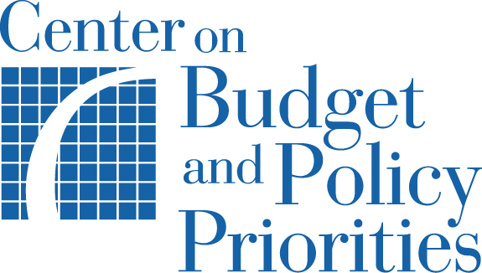
Children’s Advocates Roundtable
Severe Risk to Children’s Health Coverage Due to Federal Policy Changes
June 8, 2017

Slide 2
Timing of Threats to Medicaid, ACA and CHIP
Senate consideration of House-passed health bill
Medicaid used as “offset” to pay for other legislation (e.g., tax legislation, debt ceiling, etc.)
Medicaid used as “offsets” for other health legislation (e.g., health extenders)
CHIP and Medicaid cuts as part of CHIP extension

Slide 3
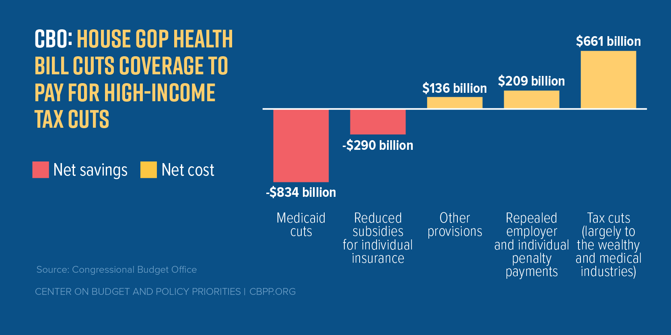
Structure of House Bill (AHCA)

Slide 4
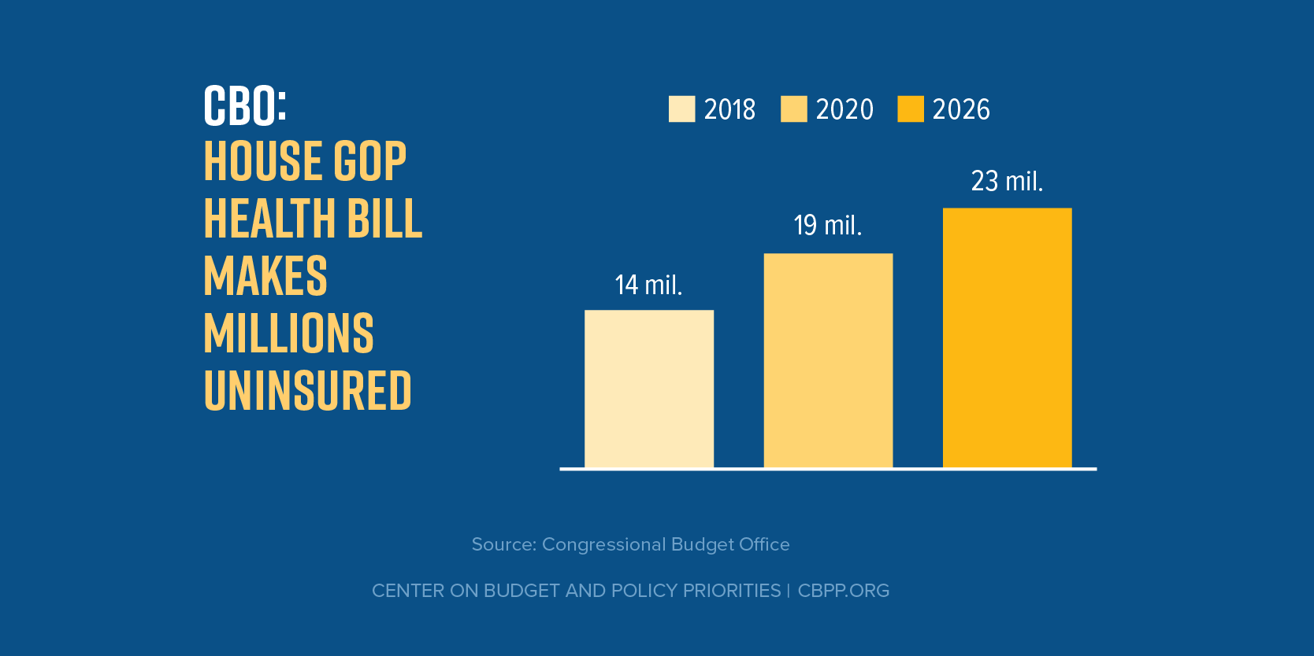
Updated CBO Cost Estimate of
House Bill

Slide 5
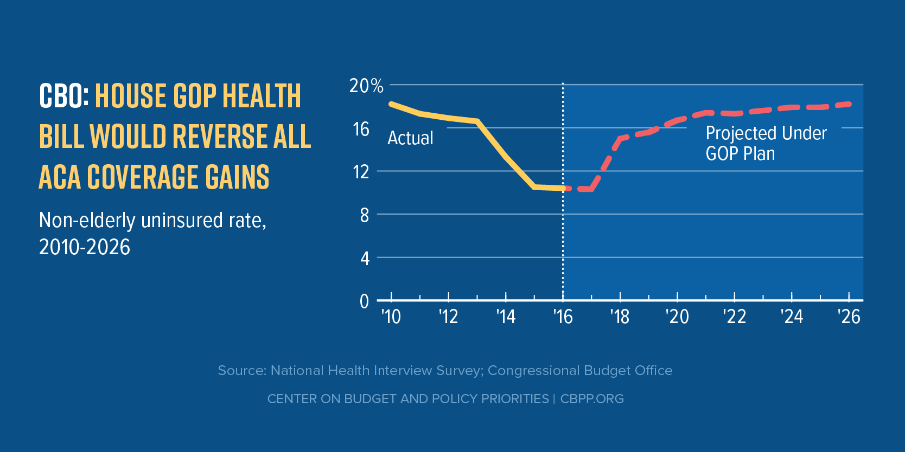
Reversal of All Coverage Gains under Affordable Care Act

Slide 6
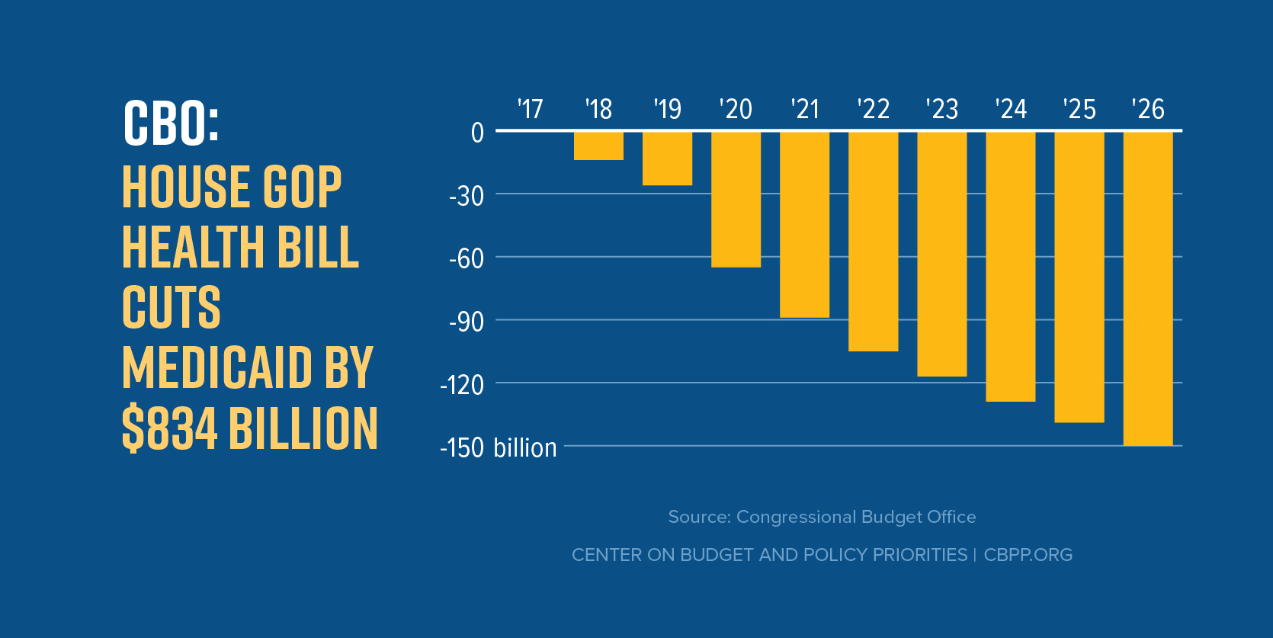
Large and Growing Medicaid Cuts

Slide 7
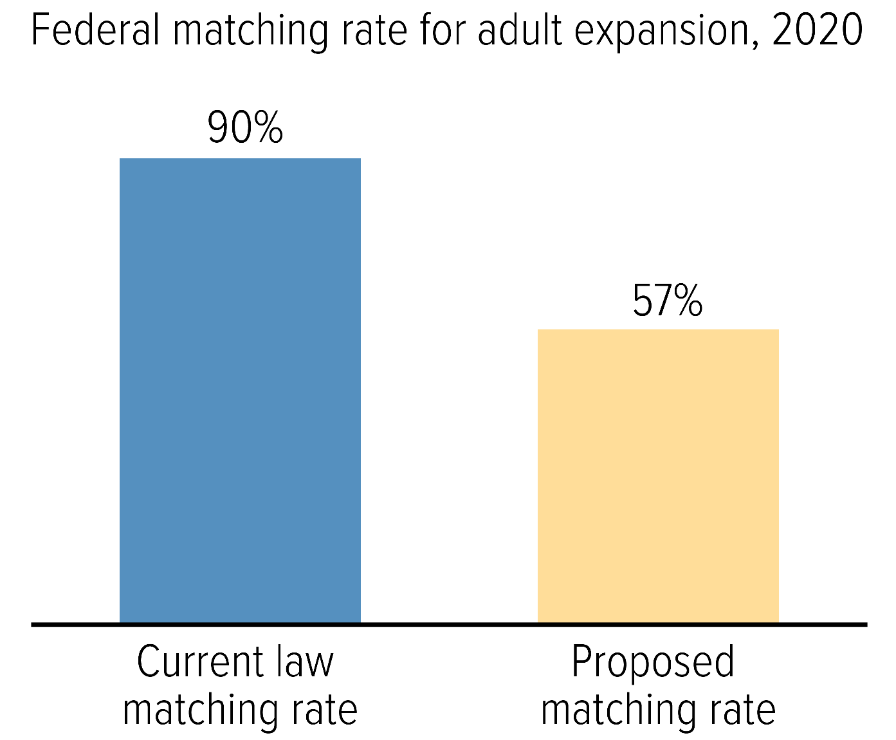
Expansion Matching Rate Reduced to Regular Matching Rate for New Enrollees

Slide 8
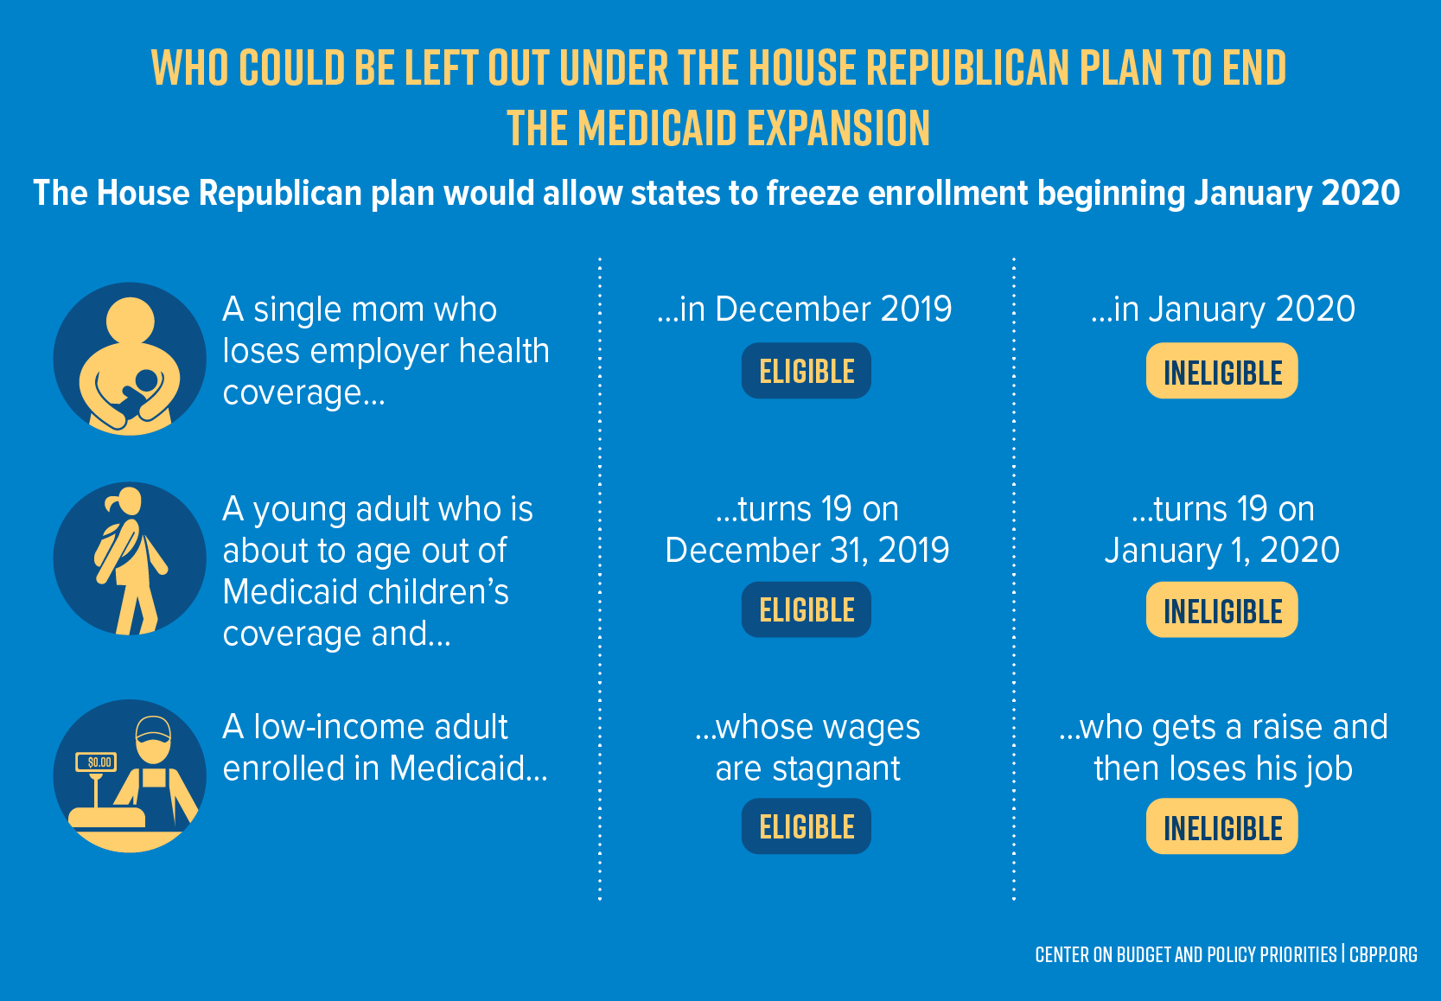
States Can Freeze New Expansion Enrollment

Slide 9
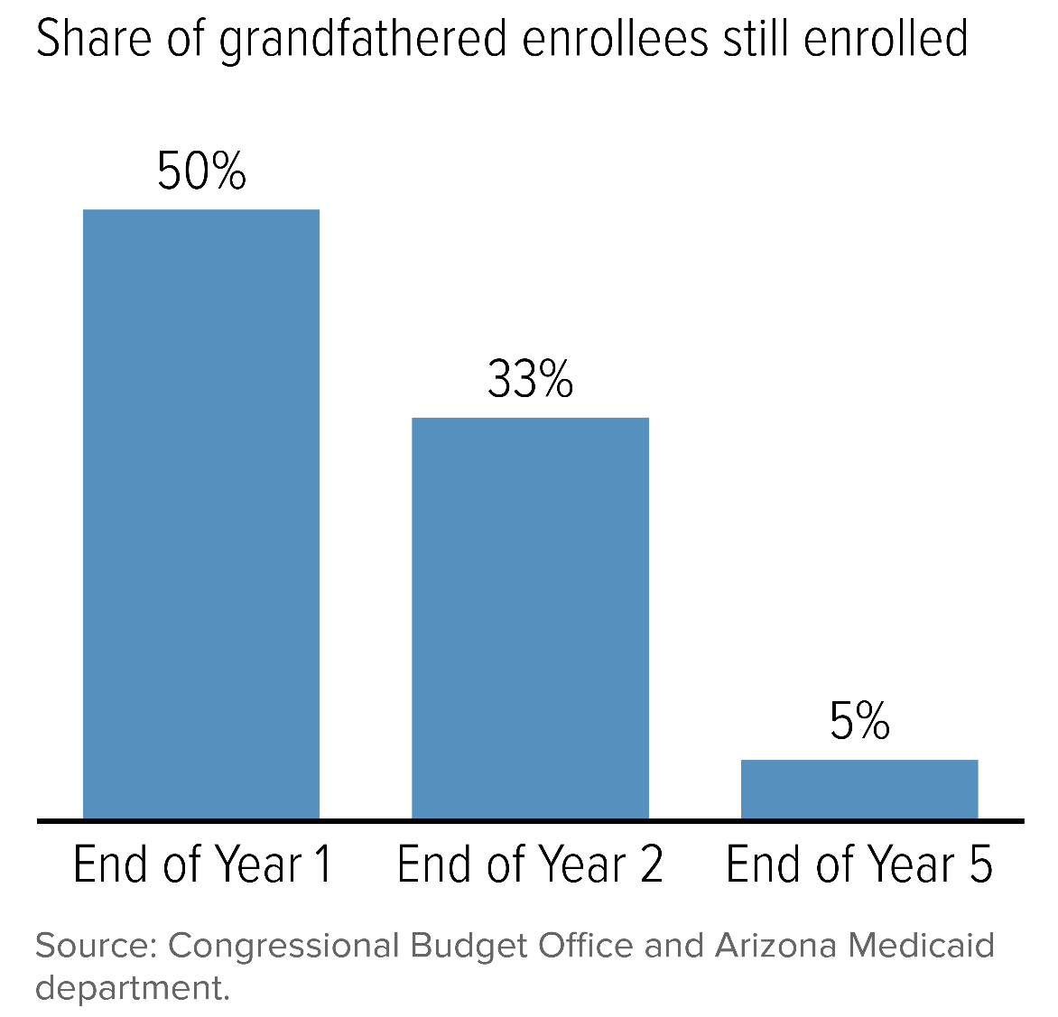
Effective End of Expansion Over Time

Slide 10
House Bill Would Cap Federal Funding
A Medicaid per capita cap or block grant would shift costs to states
Current Medicaid Financing System
VS
Capped Federal Medicaid Funding
$120
$120
$100
$100
$100
Federal cap

Slide 11
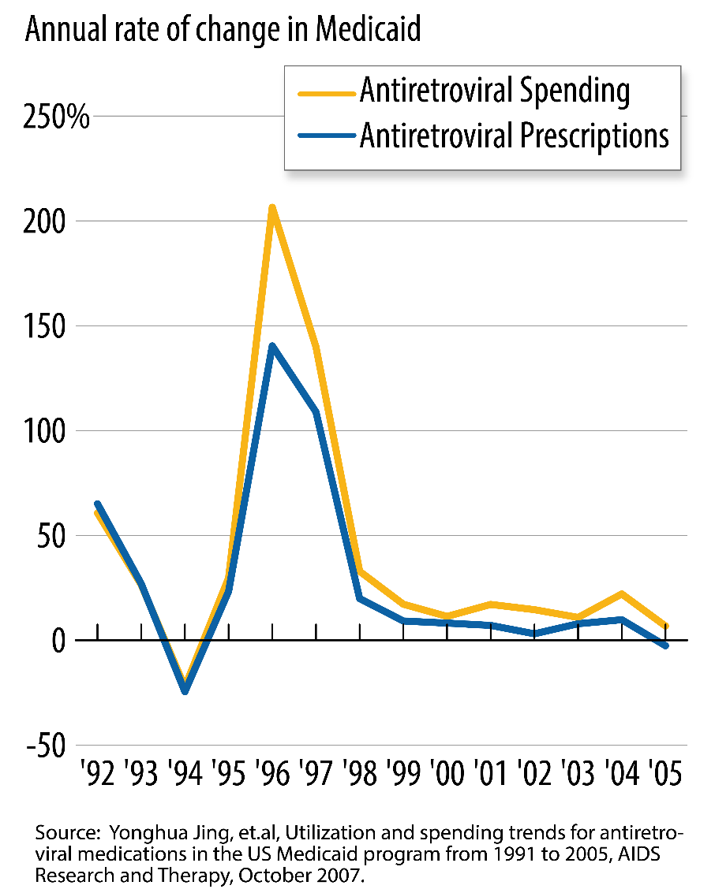
Medicaid Anti-Retroviral Drug Spending and Use More Than Doubled in 1996
The onset of the HIV/AIDS epidemic in the 1980s and early 1990s led to unexpected Medicaid costs.
Anti-retroviral prescriptions increased from 170,000 to 3 million from 1991 to 2005.
Anti-retroviral prescription spending increased from $31 million to $1.6 billion.

Slide 12
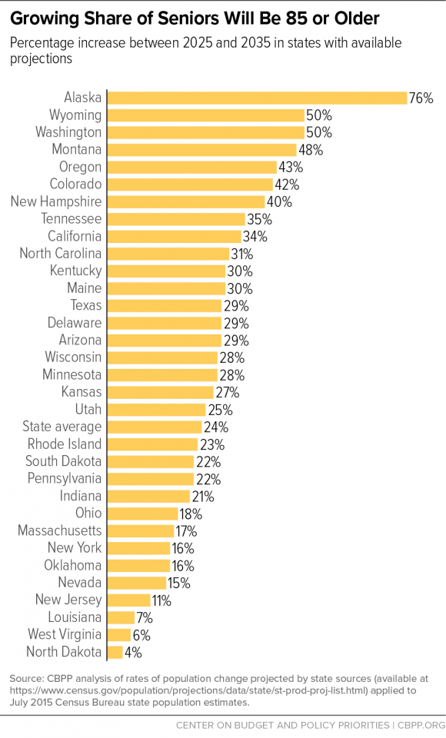
Impact of Aging of the Population

Slide 13
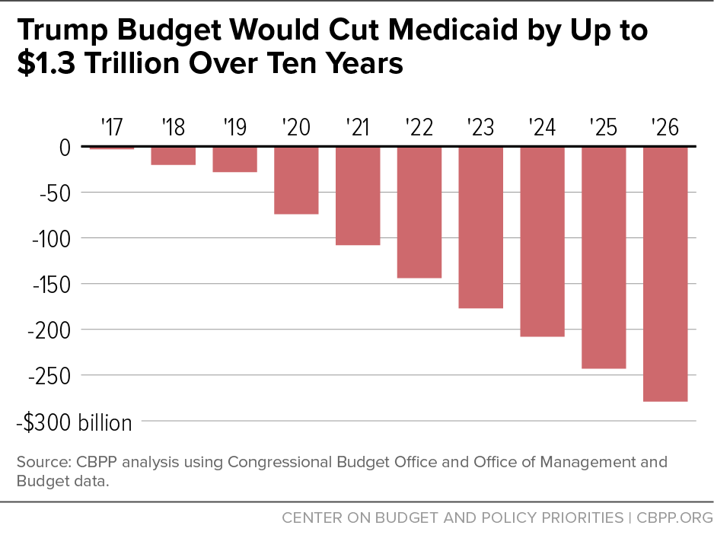
Trump Budget Proposes Even Deeper Medicaid Cuts
Medicaid per capita cap would become “piggy bank”

Slide 14
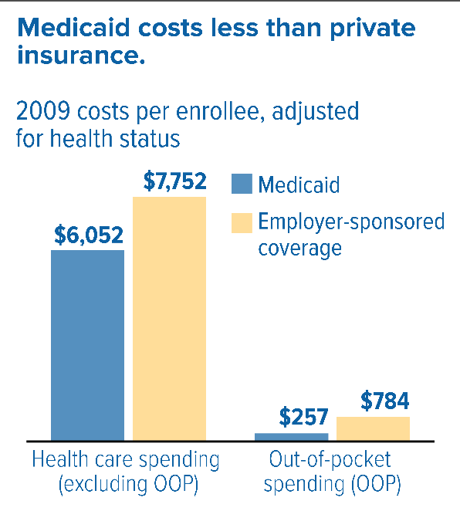
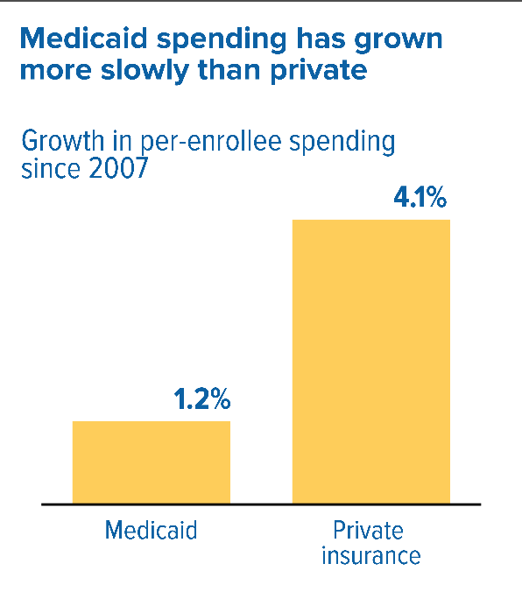
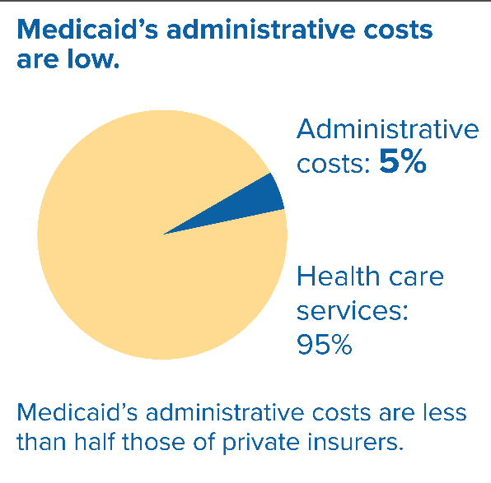
Medicaid Is Already Efficient

Slide 15
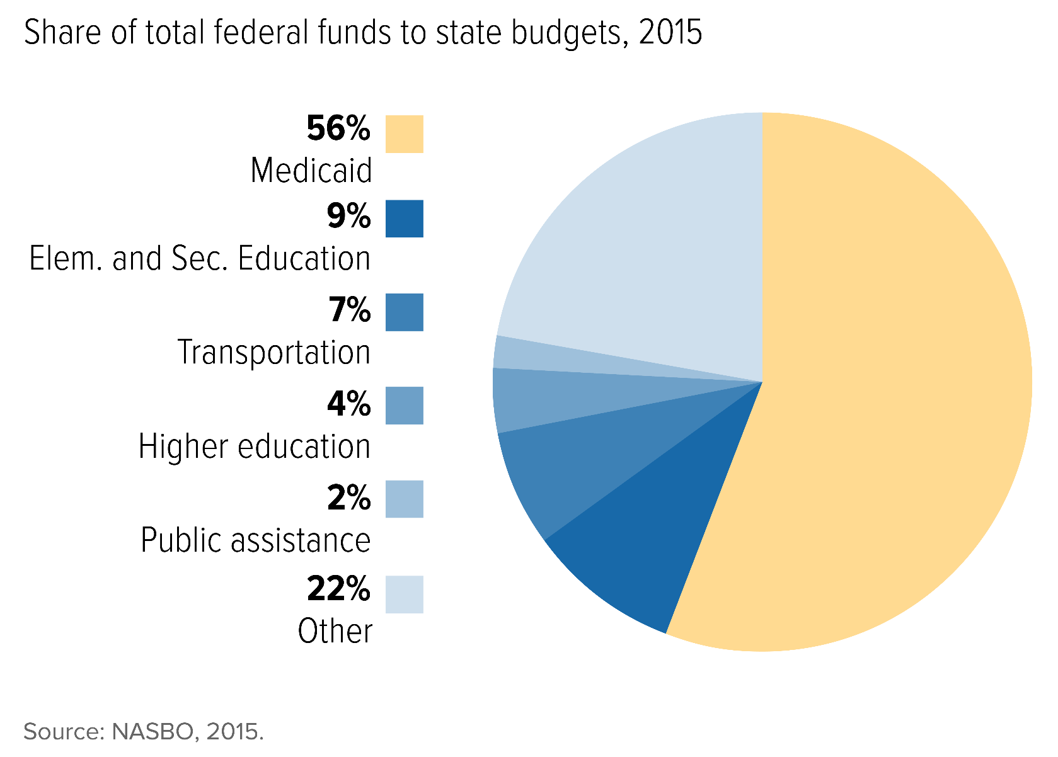
Medicaid is the Primary Source of Federal Funds to States

Slide 16
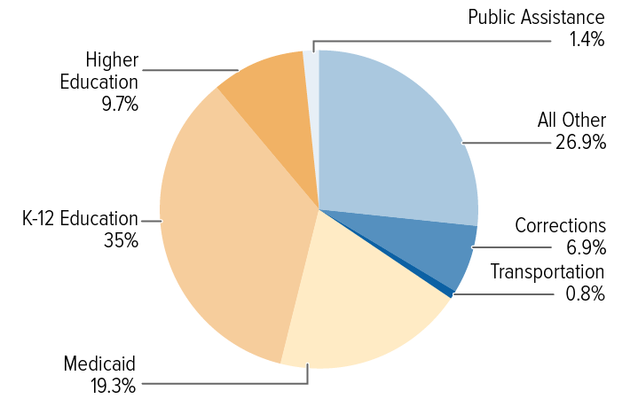
State Choices to Compensate for Federal Cuts
Raise taxes and contribute more state general revenues
Cut education, social services, other parts of budget
Cut Medicaid spending
State General Fund Expenditures

Slide 17
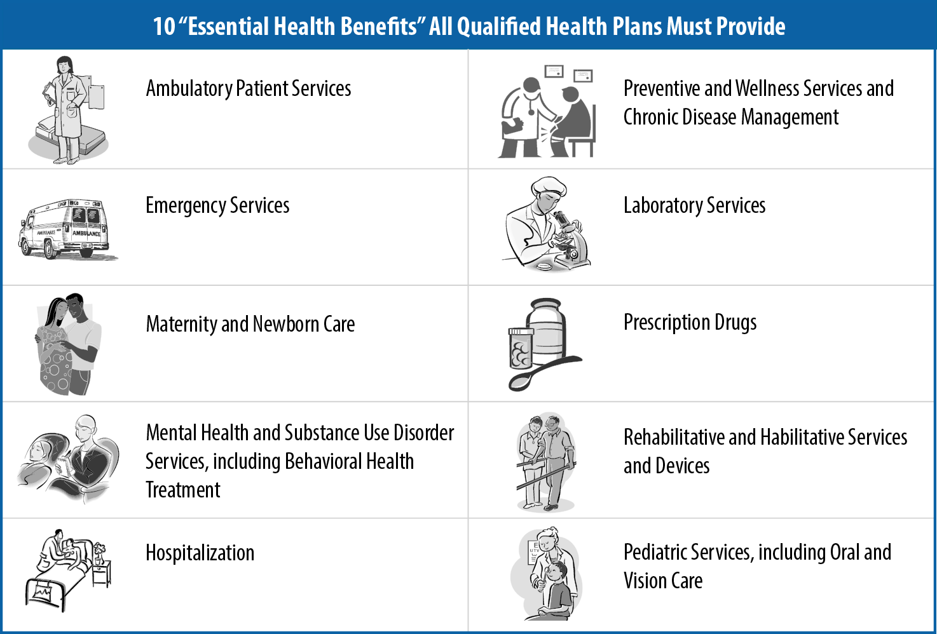

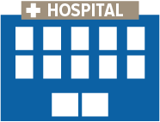


Most Likely: Medicaid Cuts
Cut Medicaid benefits, eligibility and provider payment rates.
1.
2.
3.

Slide 18
Why No Population or Service Can Be Protected from Medicaid Cuts
Cap on federal spending per beneficiary is sum of:
  Each population per capita cap multiplied by enrollment in that population
All populations are vulnerable to cuts, irrespective of how much each population’s cap contributed to total federal funding shortfall.

Slide 19
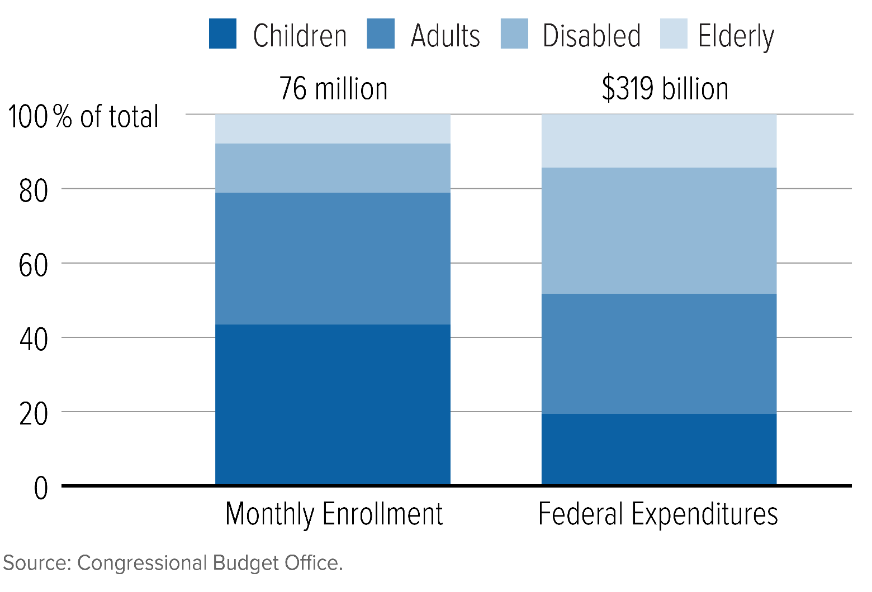
Distribution of Medicaid Spending Also Means No Groups Can Be Protected
Seniors and people w/ disabilities are 20% of enrollment but account for 50% of spending.
Children are nearly half of enrollment but only 20% of spending.

Slide 20
Trump Budget Would Also Cut CHIP
Extends federal CHIP funding for two more years
But would include CHIP and Medicaid cuts as part of extension proposal:
  Elimination of 23 percentage point matching rate increase
  Elimination of maintenance of eligibility requirement
  Lowering of matching rate for children above 250% FPL
  Elimination of “stairstep” requirement
  Expiration of Express Lane Eligibility
Risk of Additional Medicaid “Offsets” to Pay for CHIP

Slide 21
Edwin Park
park@cbpp.org
@EdwinCBPP
www.cbpp.org

