Slide 1
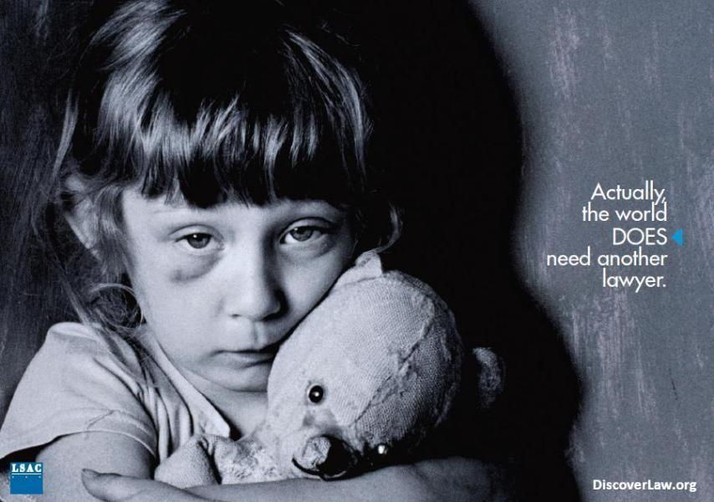

US Dept. of Health & Human Services
Enforcement of Child Welfare Standards:
A Better Option Than Reform Litigation

Slide 2
Children’s Advocacy Institute
Founded at the USD School of Law in 1989
California’s premiere academic, research, and advocacy organization seeking to improve the lives of children and youth
Special emphasis on improving the child protection and foster care systems and enhancing resources that are available to youth aging out of foster care and homeless youth.
Offices in San Diego and Sacramento, California, and in Washington, D.C.
Seeks to leverage change for children and youth through impact litigation, regulatory and legislative advocacy, and public education.
Active at the local, state, and federal levels, CAI’s efforts are multi-faceted — comprehensively and successfully embracing all tools of public interest
advocacy to improve the lives of children and youth.

Slide 3
CAI Team
Robert C. Fellmeth -- Executive Director -- cpil@sandiego.edu
Elisa Weichel -- Administrative Director/Staff Attorney -- eweichel@sandiego.edu
Christina Riehl -- Senior Staff Attorney -- criehl@sandiego.edu
Melanie Delgado -- Staff Attorney -- mdelgado@sandiego.edu
Ed Howard (Sacramento) -- Senior Policy Advocate/Senior Counsel -- eh4@sbcglobal.net
Amy Harfeld (Washington, D.C.) -- National Policy Director/Senior Staff
Attorney -- amyharf@hotmail.com
Mercedes Lanznaster -- Executive Assistant -- mlanznaster@sandiego.edu
Christina Falcone -- Executive Assistant -- cfalcone@sandiego.edu
________________________________________________________________________
Kara Hatfield -- Assistant Professor of Law, Phoenix School of Law -- khatfield@phoenixlaw.edu

Slide 4
How Does Our Policy Work Help Children?
Federal Laws
State Laws
County Policies
No Child Protection Unless There is Enforcement

Slide 5
No Child Protection Unless There is Enforcement
What do you mean, “enforcement”?

Slide 6


We are speaking of . . .
&

Slide 7


Where . . .
carrots are
and sticks are

Slide 8
Overview of Major Federal
Child Welfare Laws
Program | 2012 $ | Examples of Min. Req.
Foster Care Program (Title IV-E) The purpose is to enable each state to provide foster care &transitional independent living programs & adoption assistance for children with special needs. | $4.288 billion | Standards for Foster Family Homes to protect safety & civil rights Periodic reviews of foster care maintenance payments & AAP to assure appropriateness Standards that ensure children in placement are provided quality services that protect their health & safety 42 U.S.C. §671(a)
See handout: “Overview of Major Federal Child Welfare Laws,” which will also be posted on NACC conference website

Slide 9
Overview of Major Federal
Child Welfare Laws
Program | 2012 $ | Examples of Min. Req.
Promoting Safe and Stable Families Program (Title IV-B, Subpart 2-PSSF) Mandatory Used for family support services, family preservation services, family reunification services, & adoption promotion & support services. | $345 million | coordination of the provision of services not more than 10% of expenditures shall be for administrative costs, and the remaining expenditures shall be specifically for programs in administering and conducting service programs under the plan, the safety of the children to be served shall be of paramount concern 42 U.S.C. §629b(a)
See handout: “Overview of Major Federal Child Welfare Laws,” which will also be posted on NACC conference website

Slide 10
Overview of Major Federal
Child Welfare Laws
Program | 2012 $ | Examples of Min. Req.
CAPTA Child Protective Services State Grant Program Used to operate programs to improve the investigation & Prosecution of suspected CAN cases in a manner that limits additional trauma to the child and the child's family. | $26 million | immediate steps taken to protect the safety of a victim of CAN confidentiality of records public disclosure of the findings or information about the case of CAN which has resulted in a child fatality or near fatality Appointment of an appropriately trained GAL for every child involved in a judicial proceeding as a victim of CAN 42 U.S.C. §5106a(b)
See handout: “Overview of Major Federal Child Welfare Laws,” which will also be posted on NACC conference website

Slide 11
Overview of Major Federal
Child Welfare Laws
Program | 2012 $ | Examples of Min. Req.
Child Welfare Services Program (Title IV-B, Subpart 1-CWS) Used to promote state flexibility in services that utilizes ensure all children are raised in safe, loving families. | $281 million | diligent recruitment of potential foster & adoptive families services to help children at risk of foster care placement remain safely with their families or help those removed achieve permanency ensure that children are visited on a monthly basis by a caseworker that is focused on issues pertinent to case planning & services 42 U.S.C. §622(a) & (b)
See handout: “Overview of Major Federal Child Welfare Laws,” which will also be posted on NACC conference website

Slide 12
Federal courts have found and states have admitted violations of these statutes
Caseload and case management violations
  High social worker caseloads
  High social worker turnover rates
  Insufficient training of social workers
  Inadequate social worker staffing and management practices
Juan F. v. Malloy (CT)
Dwayne B. v. Snyder (MI)
Olivia Y. v. Barbour (MS)
D.G. v. Henry (OK)
Many more in other states

Slide 13
Other violations federal courts have addressed
Foster care compensation shortfall and supply diminution
  MARC Study
  Privately Enforceable Right
    CA State Foster Parent Assoc. v. Wagner
  Straightforward Discovery

Slide 14
Other violations federal courts have addressed (for which DHHS might now be the only enforcer)
Outrageous GAL caseloads, or failure to provide any GAL at all
  Kenny A. v. Perdue (N.D. Ga. 2002-??)
  E.T. v. Cantil-Sakauye (E.D. Cal. 2009-??)
  Henry A. v. Willden (D. Nev. 2010-??)
Problem with enforceability through courts

Slide 15
Other violations raised in courts, which have largely been resolved by consent decrees
See handout “Details regarding Selected Private Lawsuits Challenging State Compliance with Federal Child Welfare Laws”
Representative sample of 26 of more than 111 lawsuits filed in the last few decades alleging failures by state and county child welfare agencies to provide services to abused and neglected children that are required by federal (and sometimes state) law

Slide 16
An unexpected proposal for a bunch of lawyers to make:
Federal agency enforcement of child welfare service standards would be better than litigation!
  Abused and neglected children and children living in foster care would be better served and have improved life outcomes if DHHS would enforce federal child welfare service standards through withholding federal money from states who are not in compliance
    The states will reform their practices and
    deliver the required services, FAST!

Slide 17
Limitations of Pursuing Child Welfare Reform through Litigation
Federal judicial check is of limited efficacy
  Lack of child access to judicial branch
  Remedy and standing issues
  Willing plaintiffs
  Inconsistent results
  Cost
  Delay
  Limited coverage

Slide 18
Pursuing reform through litigation has problems
  Lack of child access to judicial branch
  Children need some adult to bring a claim on their behalf
  Children need a lawyer to pursue the claim
  Federal courts are denying access
    “abstention” - E.T. v. Cantil-Sakauye (9th Cir. 2012)
    denial of standing (Blessing) – Henry A. v. Willden (9th Cir. 2012)

Slide 19
Pursuing reform through litigation has problems
Remedy and standing issues
  No private standing to enforce Adoption Assistance and Child Welfare Act of 1980 (CWA)
    Suter v. Artist M. (U.S. 1992)
    The “Suter fix” – seems to only extend to certain parts of the CWA
  If no private plaintiff can get a court to look at the state’s failures, no remedy will be available/ordered
  Children who are initially plaintiffs “age out” or are adopted and lose standing they had, necessitating dismissal (Clark K. v. Willden) or substituting
  plaintiffs via an amended complaint

Slide 20
Pursuing reform through litigation has problems
Willing plaintiffs
  Children and their foster parents – it’s a burden
  Creates overt conflict with those on whom children depend for the few services they are getting . . . AWKWARD!!!
  Sometimes requires professionals to admit their own deficiencies . . . CAREER SUICIDE???

Slide 21
Pursuing reform through litigation has problems
Inconsistent results
  Most cases resolve by consent decree, leaving no imprint on case law and therefore offering no legal authority to bolster similar suits in other locations
  State-by-state (or even county-by-county) orders/consent decrees mean different standards in every place
  State or Circuit variations, even on the preliminary issue of standing (contrast Kenny A. with Henry A.)

Slide 22
Pursuing reform through litigation has problems
Cost
  Missouri Child Care v. Martin – resolved at summary judgment; $250,000 in attorneys’ fees for plaintiffs
  California Alliance of Child and Family Services v. Allenby/Wagner - $1 million in attorneys’ fees for plaintiffs
  Kenny A. v. Perdue - $6 million in attorneys’ fees for plaintiffs
  Sometimes state is ordered to pay plaintiffs’ fees, but always incurs its own defense costs (valued at $6 million in Kenny A.)
  Court costs for judges, bailiffs, clerks
  Other costs: social worker time, monitors after settlement agreement/consent decree

Slide 23
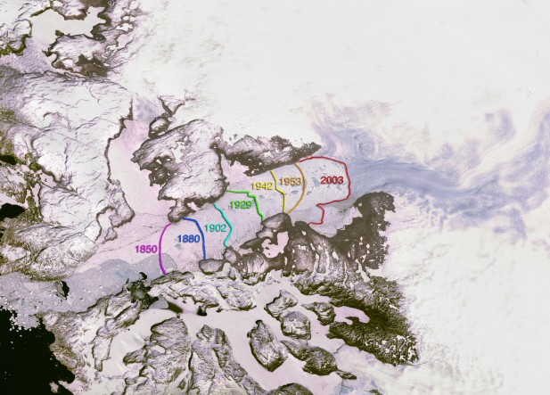
Pursuing reform through litigation has problems
Delay
  The speed of reform can often be described as “glacial”
Jakobshavn Isbrae, Greenland’s largest outlet glacier

Slide 24
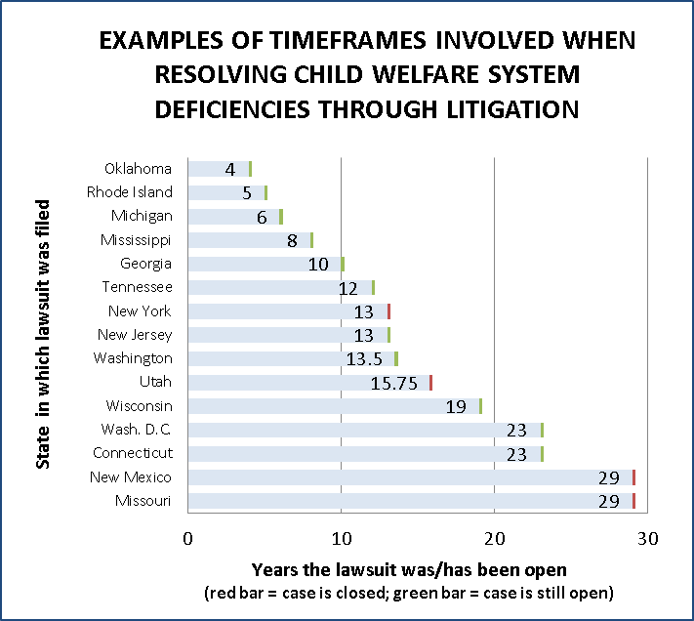

Slide 25
Pursuing reform through litigation has problems
Limited Coverage – type of problem
  California Alliance of Child & Family Services v. Allenby (filed 2006) – inadequate foster care maintenance payments to group home providers
  California State Foster Parent Association v. Wagner [Lightbourne] (filed 2007) – inadequate foster care maintenance payments to foster family home providers
  California Alliance of Child & Family Services v. Lightbourne (filed 2012) – inadequate foster care maintenance payments to foster family agency
  foster care providers

Slide 26
Pursuing reform through litigation has problems
Limited Coverage - geography
  G.L. v. Sherman (filed 1980)– 1 of 118 counties in Missouri
  Jeanine B. v. Walker (filed 1993) – 1 of 72 counties in Wisconsin
  Kenny A. v. Perdue (filed 2002) – 2 of 159 counties in Georgia
  Clark K./Henry A. v. Willden (filed 2006 & 2010) – 1 of 17 counties in Nevada
  E.T. v. Cantil-Sakauye (filed 2009) – 1 of 58 counties in California

Slide 27
Pursuing reform through litigation has problems
Limited Coverage – type of problem and geography combined
  Frequent allegations in child welfare reform litigation:
Abuse or neglect of children in foster care
Placement instability
Children reunified with families soon re-enter foster care
Lack of foster family homes, leading to group/institutional placements
Failure to provide medical, mental health and/or dental services and/or educational services
High caseloads, high turnover, poorly trained caseworkers and/or failure to visit children in care
Children placed in unlicensed foster homes
Failure to provide family maintenance and/or reunification services
High caseloads of attorneys for children, or failure to provide GAL in dependency court proceedings
Failure to investigate allegations of abuse or neglect
Lack of permanency planning and/or adoptive home development
Inadequate foster care provider compensation
Other

Slide 29
Pursuing reform through litigation has problems
Limited Coverage - time
  Consent decrees sometimes have specific date expirations (courts have been unwilling to extend the agreed-upon date)
  Consent decrees sometimes have “results” expirations (court oversight ends when monitor reports certain results achieved; future deficiencies –even of the original type – require filing a new suit)

Slide 30
Current US DHHS Monitoring/
Enforcement Mechanisms
DHHS’ Primary Monitoring and Enforcement Mechanisms Currently Consist of:
  State Plans
  Child and Family Services Reviews
  Title IV-E Foster Care Eligibility Reviews
  Partial Reviews
  Adoption and Foster Care Analysis and Reporting System
  Statewide Automated Child Welfare Information System Assessment Review

Slide 31
Current US DHHS
Monitoring/Enforcement Practices
State Plans
  Submitted by State to DHHS for eligibility for funding through certain federal programs
  Concerns:
  Passive approach toward oversight
  To view your states’ State Plan, visit the website of your states’ primary child
  welfare agency

Slide 32
Current US DHHS
Monitoring/Enforcement Practices
Child and Family Service Reviews
  Used by DHHS to ensure states’ conformity with some IV-B and IV-E requirements
  Two part process:
    DHHS assesses statistics as reported by state agencies
    Teams reviews samples of individual cases
  Assesses states for “substantial conformity” with seven outcomes and seven systemic factors

Slide 33
Current US DHHS
Monitoring/Enforcement Practices
Child and Family Service Reviews (cont’d)
7 Outcomes
Safety
  Children are protected from abuse and neglect.
  Children are safely maintained in their homes whenever possible and appropriate.
Permanency
  permanency and stability in living situations.
  continuity of family relationships is preserved.
Family and Child Well-Being
  Families have enhanced capacity to provide for children's needs.
  Children receive appropriate services for education
  Children receive adequate services for physical & mental
  health

Slide 34
Current US DHHS
Monitoring/Enforcement Practices
Child and Family Service Reviews (cont’d)
7 Systemic Factors
Statewide Information System
Service Array
Case Review System
Staff Training
Quality Assurance System
Agency Responsiveness to the Community
Foster & Adoptive Parent Licensing, Recruitment, & Retention

Slide 35
Current US DHHS
Monitoring/Enforcement Practices
Child and Family Service Reviews (cont’d)
What’s supposed to happen if a state is not in “substantial conformity” with federal standards?
  State submits (PIP) to ACF for approval
  DHHS will withhold federal matching funds if a state’s program fails to substantially conform to federal law although DHHS must first
    afford the state an opportunity to implement a corrective action plan;
    make technical assistance available to the state
    suspend the withholding while such a corrective action plan is in effect; and
    rescind withholding if the failure to so conform is ended
    by successful completion of corrective action plan.

Slide 36
Current US DHHS
Monitoring/Enforcement Practices
Child and Family Service Reviews (cont’d)
Concerns:
  Re PIP completion, DHHS does not hold states to the same thresholds it uses during the CFSR process.
  In Round 1 of CFSR process, DHHS found that no state was in substantial conformity with all seven outcome areas and all seven systemic factors.
  Round 2 of CFSR process - DHHS again found that no state was in substantial conformity with all seven outcome areas and all seven systemic factors.
  http://library.childwelfare.gov/cwig/ws/cwmd/docs/cb_web/
  SearchForm

Slide 37
Current US DHHS
Monitoring/Enforcement Practices
Foster Care Eligibility Reviews
Focus on determining whether children in foster care meet the federal eligibility requirements for foster care maintenance payments
The review team examines cases for specific federal eligibility requirements, such as:
  A court order re need to remove the child
  A court order re the state’s reasonable efforts
  Completed criminal background checks
  Compliance with safety requirements for foster homes
  Licensed foster care providers
  Needs-based test to confirm the child's eligibility

Slide 38
Current US DHHS
Monitoring/Enforcement Practices
Foster Care Eligibility Reviews (cont’d)
What’s supposed to happen if a state is not in “substantial conformity” with federal standards?
  Payment Disallowance
  If state not in substantial compliance they must develop and implement a Program Improvement Plan, after which a secondary review is conducted.
  After the secondary review, if the state is still not in substantial compliance, larger disallowance assessed.
  http://library.childwelfare.gov/cwig/ws/cwmd/docs/
  cb_web/SearchForm

Slide 39
Current US DHHS
Monitoring/Enforcement Practices
Partial Reviews
  DHHS process for determining conformity with state plan requirements outside the scope of the CFSRs
  ACF must have reason to believe that a state is not in compliance with its state plan or applicable federal law
  If ACF conducts a partial review process, and finds a state to be out of conformity, ACF may withhold federal funds

Slide 40
Current US DHHS
Monitoring/Enforcement Practices
Partial Reviews (cont’d)
Child advocates’ concerns regarding partial review process:
  Under-utilization by ACF
  Passive approach adopted by ACF

Slide 41
Current US DHHS
Monitoring/Enforcement Practices
Comment on DHHS’ Use of Penalties in Response to States’ Noncompliance with Child Welfare Standards
While some advocates contend that penalties might ultimately harm the children meant to be served by child welfare programs,
  a state’s ongoing failure to comply with federal standards definitely harms the children meant to be served;
  several state officials contend that they have a hard time convincing their legislatures of the need for a change without federal dollars being at risk
  the threatened imposition of penalties can in and of itself bring states into compliance -- if states believe the threat to be real

Slide 42
Examples of Federal Enforcement re Other Issues/Constituencies
Survey of newspaper articles from across the nation in the last 25 years
The articles report the federal agency has made the threat, and only very rarely is there a later article reporting that the state failed to meet the federal agency’s demand and ultimately lost the federal funding

Slide 43
You’re familiar with federal enforcement on other issues
Health Care Financing Administration – threatens to and does cut off Medicare/Medicaid funding to hospitals not in compliance (AR, CA, D.C., IL, IN, KY, MN, NE, NM, TX, and others)
Environmental Protection Agency – threatens to cut off road project funds when air quality standards are not met (MI, KY, NM)
Justice Department – threatens to cut off funding for failures to comply with ADA structural requirements (TN)
Depts. of Interior and Justice, EPA and Army Corps of Engineers – threaten to cut habitat restoration funds for failure to reduce pollution into the Everglades (FL) and
Chesapeake Bay (PA)

Slide 44
More examples of the feds making states comply in order to receive $$
Dept. of Housing & Urban Development – threatens to cut funds for failure to comply with anti-discrimination requirements (NE, PA)
Justice Department – threatens to cut off funding for failures to comply with voting system standards (NY)
Federal Transit Administration – threatens to withhold federal stimulus funds for BART’s failure to study Oakland Airport Connector’s impact on minority communities (CA) and failure to comply with “Buy American” rule in light rail car purchase (TX)
Environmental Protection Agency – threatens to withhold federal stimulus funds for failure to comply with
“Buy American” rules in purchases of construction
materials for wastewater treatment plant (IL)

Slide 45
Some federal agency enforcement/threats to withhold money related to certain issues affecting children . . .
Dept. of Education – re special education funding formula (NY), educational progress of the state’s poorest students (FL), No Child Left Behind compliance (UT), grant program requirements (Guam) and Head Start and Early Head Start programs (CA, NV)
Environmental Protection Agency – re lead paint removal program (MS)
US DHHS, Substance Abuse and Mental Health Administration – re tobacco sales to minors (D.C., DE, IA, MN, MO, NE, OR, RI, WI, WV, WY)

Slide 46
. . . but DHHS isn’t enforcing child welfare service standards
We asked them to show us what they’ve done . . .
FOIA request submitted, still waiting for responsive documents:
Copies of signed correspondence from ACF to state officials addressing noncompliance or potential noncompliance with title IV-B, IV-E and CAPTA for the time period of January 1, 2010 to
May 24, 2012, including but not limited to any signed correspondence from ACF to a state indicating that a state’s receipt of federal funding will or might be in jeopardy if ACF determines the state is not in compliance with the requirements of IV-B, IV-E
or CAPTA.

Slide 47
DHHS says caseworker training, turnover and caseloads isn’t its domain:
FOIA request submitted, with response that ACF has no responsive documents
  Inquiries by ACF to state agencies re: inadequate or underfunded foster care caseworkers training, caseworker turnover rates or caseworker caseloads
  “[T]he topics mentioned are ones over which states have discretion in operating their
  Title IV-B and IV-E programs. Therefore, these matters are not ones for which ACF would or could find a State not in conformity with . . . the Social Security Act.”

Slide 48
Here’s one publicized example of DHHS enforcement in child welfare law, which proves it works:
In 1999, New York was the only state that hadn’t implemented state guidelines to correspond to federal law signed in 1997, the Adoption and Safe Families Act
DHHS (repeatedly) threatened New York’s legislature that if it didn’t enact compliant guidelines, FAST, New York would lose $450 million in federal funds
Just before the expiration of a third DHHS extension deadline, the NY legislature
passed a bill and averted the funding cuts

Slide 49
Another example proving it works:
US DHHS enforcement re
Title IV-D, Child Support
Controlled by Office of Child Support Enforcement
  Also controlled by Administration for Children and Families of DHHS
Requirement of statewide Child Support Collection Computer Automation
Mix of incentives (90% of computer costs if deadlines met) and penalties
Penalties both threatened and imposed: 48 states comply
California is major hold-out due to fragmentation of County District Attorneys collecting child support
  The Legislature, facing more penalties, removes all DA jurisdiction, creates statewide collection office and imposes statewide computer system

Slide 50
DHHS enforcement would be better
When federal agencies have threatened to cut off funds for Medicare/Medicaid, highway construction, housing, schools, substance abuse and mental health treatment, (BASICALLY ANYTHING), states have moved quickly to correct deficiencies and avert funding cuts or have funding restored

Slide 51
DHHS enforcement would be better, except when . . .
The ironic Oklahoma example

Slide 52
DHHS Defenses and Obstacles
ACF Budget Limitations
State Sovereignty and Respect for Federalism
Structural Flaws (e.g., Limited Underlying CAPTA Funding)
Economy Considerations (Public Sector Spending Cut Pressure)

Slide 53
Examples of Child Welfare Issues in Need of Affirmative US DHHS Oversight
Secrecy and child abuse deaths/near deaths
Denial of attorney representation/GALs for children
Direct fleecing of foster children by the states
  Federal law and foster children adult self-sufficiency

Slide 54
FINDINGS
DHHS has a duty as part of the Executive Branch to enforce Congressional intent
Litigation is an increasingly problematic check on state compliance, and suffers from:
  Cost, Delay, and Geographic/Time Limitations
Federal insistence/penalties are an effective inducement

Slide 55
RECOMMENDATIONS
Because CAPTA does not provide sufficient federal monies to assure compliance, federal law should include CAPTA requirements (disclosure, GALs, etc.) by reference within the high funded provisions of IV-B and/or IV-E
Child advocates need to politically pressure federal officials to enforce the law and not be fooled by the false mantra “Penalties deprive children of resources”
  FOIA request: http://www.acf.hhs.gov/foia/foia_request.html.
Advocates need to: (a) know where prior litigation has produced findings or admissions of violation requiring remediation; (b) know what academic studies indicate serious shortfalls in their state; and (c) make the case to federal ACF regional officials where violations occur
Litigate prudently where other leverage alternatives are lacking, focusing on areas of violation where precedents or
parallels exist

Slide 56
Contact your ACF Regional Office to report violations and request enforcement
Region I -- Mary Ann Higgins, JFK Federal Bldg., Room 2000, 15 New Sudbury Street, Boston, MA 02203 (617) 565-1020
Region II -- Joyce Thomas, 26 Federal Plaza, Rm. 4114, New York, NY 10278 (212) 264-2890
Region III -- David Lett, 150 S. Independence Mall West, Suite 864, Philadelphia, PA 19106-3499 (215) 861-4000
Region IV -- Carlis Williams, Atlanta Federal Center, 61 Forsyth Street, SW, Suite 4M60, Atlanta, GA 30303-8909 (404) 562-2900
Region V -- Kent Wilcox, 233 N. Michigan Avenue, Suite 400, Chicago, IL 60601 (312) 886-6375

Slide 57
Contact your ACF Regional Office to report violations and request enforcement
Region VI -- Leon R. McCowan, 1301 Young Street, Suite 914, Dallas, TX 75202 (214) 767-9648
Region VII -- Patricia Brown, 601 East 12th Street, Room 276, Kansas City, MO 64106 (816) 426-3981
Region VIII -- Thomas Sullivan, 999 18th Street, South Terrace, Fourth Floor, Denver, CO 80202 (303) 844-3100
Region IX -- Sharon Fujii, 90 7th Street, 9th Floor, San Francisco, CA 94103 (415) 437-8400
Region X -- Steve Henigson, 2201 Sixth Avenue, Suite 300, M/S RX-70, Seattle, WA 98121 (206) 615-3660

Slide 58
THANK YOU FOR THE WORK YOU DO IN SUPPORT OF CHILDREN, YOUTH and FAMILIES!

