Slide 1

Struggling to Survive: LGBTQ+ Youth on the Streets of California
Shahera Hyatt, Dir. CA Homeless Youth Project

Slide 2

Youth Homelessness in California
Nearly 300,000 homeless students identified in CA's public schools in the 2013-14 school year – 5% of our student body
CA has the largest number of homeless youth in the country, nearly 80% are unsheltered (2013 PIT Count)
2/3rds of CA’s counties have no shelters specifically designed to serve youth

Slide 3
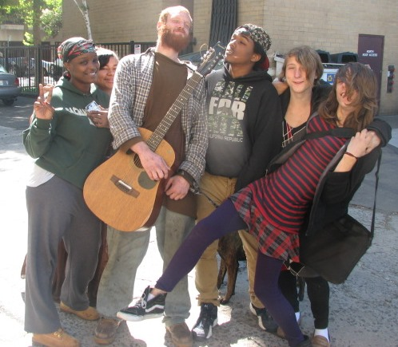
LGBTQ+ Youth
20-40% of homeless youth identify as LGBTQ
  True in urban, suburban, and rural communities
Why:
  Family rejection (25-40%);
  Poverty;
  difficulty finding culturally competent services;
  Institutionalized discrimination in the juvenile justice and social service systems

Slide 4
Characteristics
More likely to report family conflict
Increased rates of victimization at home and on the streets (3x as likely to be sexually assaulted/raped)
Increased rates of depression, PTSD, and suicidal ideation
Forced into the street economy because of institutional discrimination
  3x as likely to exchange sex for basic needs such as food, shelter, and clothing
None of this is due to deficits within the queer homeless youth community

Slide 5
Resiliency
More likely to seek out drug treatment and no more likely to engage in risky behavior like sharing needles
Defining themselves out of the mainstream gives them the ability to look at issues from different perspectives
They are driven, resourceful, and want to connect to a community
For some youth, their home may have been stable earlier on, then parents kicked them out when identity was disclosed
They are more likely to create a street family, and find power in numbers

Slide 6
Broken Systems = Broken Families
Responsibility should not only lie with the family, but also society and systems intended to protect them
Research on trajectories into homelessness look only at the individual, absolving the "system" of responsibility
Family rejection is not the only narrative that needs focus, though prevention and reunification are incredibly important when that is the case

Slide 7
Policy Recommendations: Our Responsibility
Prevent homelessness by providing support for families who may be struggling with their child's SO/GI
  Investment in Child Welfare & HY Programs
Build service capacity: Engage LGBT homeless youth in designing appropriate services that meet their needs, and better serve all youth
  Most communities in CA have ZERO programs for HY
Undo the criminalization of homelessness, which disproportionately impacts LGBT youth and youth of color
Look at legislation with the lens of these youth, who are much in need of state attention and protection

Slide 8
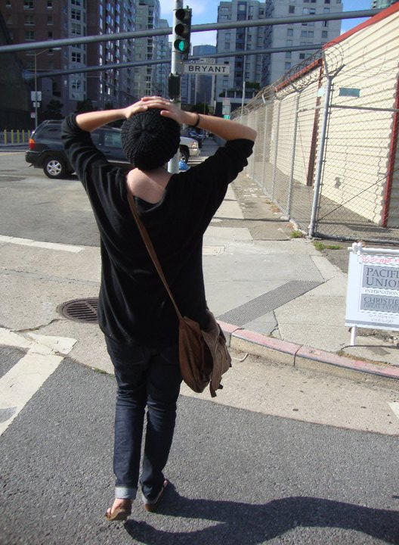
People Recommendations
Treat people experiencing homelessness w/ dignity & respect
Challenge stereotypes about “homelessness by choice” & other narratives that pathologize the individual

Slide 9
Questions?
Visit us at http://cahomelessyouth.library.ca.gov/
Email Shahera at shahera.hyatt@library.ca.gov
Twitter: @CAHomelessYouth

