Slide 1
Recent State Policy Affecting Unaccompanied Immigrant Children
November 3, 2014
Rachel Prandini, Unaccompanied Minor Law Fellow/Attorney,
Immigrant Legal Resource Center

Slide 2

Immigrant Legal Resource Center
(ILRC)
© 2014 Immigrant Legal Resource Center

Slide 3
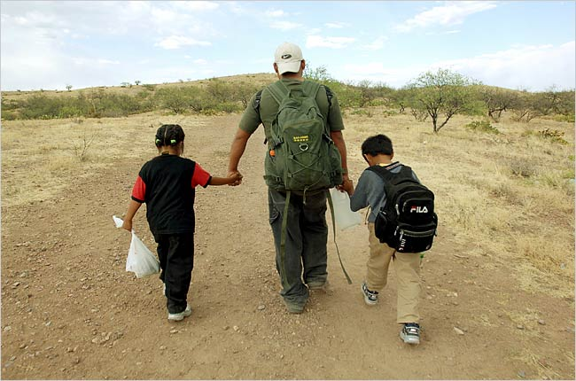
SB 873: New Unaccompanied
Minor Legislation
Notes:
REPLACE IMAGE HERE

Slide 4
SB 873
On September 27, 2014, California Governor Jerry Brown signed into law Senate Bill 873
  Provides $3 million in legal aid to unaccompanied minors in removal proceedings
  Clarifies state court roles in considering Special Immigrant Juvenile Status (SIJS) petitions filed by immigrant children
“Helping these young people navigate our legal system is the decent thing to do and it's consistent with the progressive spirit of California.” – Gov. Brown

Slide 5
SB 873
With respect to SIJS petitions in state court:
  Eliminates any ambiguity that California Superior Courts, including family courts, have jurisdiction to make the findings necessary for SIJS;
  Creates an affirmative responsibility of Superior Courts to make the SIJS findings when there is evidence to support those findings;
  Clarifies that the evidence to support the SIJS findings may consist of (but is not limited to) a declaration by the child;

Slide 6
SB 873
  Lists the specific SIJS findings that a court order should include and makes clear that when requested, the court may make additional findings;
  Increases confidentiality protections for proceedings in which SIJS findings are requested;
  Clarifies that courts may provide interpreters in proceedings requesting SIJS findings.

Slide 7
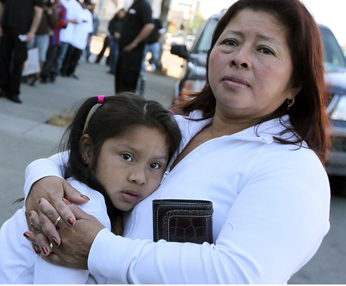
SB 1064: The Reuniting Immigrant Families Act
Notes:
REPLACE IMAGE HERE

Slide 8
SB 1064: The Reuniting Immigrant Families Act
On Oct 1, 2012, Governor Brown signed SB 1064 into law, making it the first bill in the country to address the barriers to family reunification for detained and deported immigrant families.
Notes:
SB1064 prioritizes keeping children with their families and out of the public child welfare system whenever possible and ensures that separated families receive appropriate care and due process.

Slide 9
Five Areas of Focus of SB 1064
An adult’s undocumented status alone cannot bar her from placement consideration.
Workers are required to make and document their reasonable efforts to aid detained and deported parents in receiving reunification services.
The law provides courts with new special case continuance options.

Slide 10
Five Areas of Focus of SB 1064
When foreign national parents have a court case where their children are in Department of Social Services custody, the parents’ consulate must be promptly contacted.
    This is also a U.S. treaty requirement.
Encourages efforts to assist undocumented children in DSS custody obtain immigration relief.

Slide 11
Additional Issues for UACs
Not Addressed by Recent Legislation
1. A Clarification of State Juvenile Confidentiality Laws: California should amend the current laws governing confidentiality of juvenile records to make absolutely clear that federal immigration officials are not permitted to access juvenile files unless they have a court order from a juvenile court authorizing them to do so.
  Example: As a minor residing in California, Vanessa fell victim to a child sex trafficking scheme. When her mother tried to rescue her, Vanessa was held captive and her family received threats from her adult pimp. She was arrested for loitering with intent to engage in prostitution. During the probation department’s initial intake with Vanessa, they inquired about her country of birth and immigration status.

Slide 12
Additional Issues for UACs
Not Addressed by Recent Legislation
1. A Clarification of State Juvenile Confidentiality Laws
  Example, cont.: Before her guilt or innocence had been decided in court, the probation department shared her confidential information with ICE. The probation department did so without obtaining prior court approval as required by the Welfare & Institutions Code, which would have allowed the court to determine whether such a disclosure was contrary to the minor’s rehabilitation and best interest. Vanessa is now dealing with not only the trauma of having been victim to sex trafficking, but also the constant fear of deportation to an unfamiliar country.

Slide 13
Additional Issues for UACs
Not Addressed by Recent Legislation
2. Changes to the laws governing SIJS to provide for:
A. Extension of Jurisdiction;
B. Removal of Burdensome Notice Requirements;
C. SIJS Orders to be Made at Temporary Guardianship Hearings; and
D. Denials of SIJS Requests to be Appealable Orders.
Vulnerable immigrant youth are unable to get the state court protection they need through Special Immigrant Juvenile Status in order to be able to have a chance to stay in the U.S.

Slide 14
Additional Issues for UACs
Not Addressed by Recent Legislation
A. Extension of Jurisdiction: California should extend court jurisdiction to age 21 to stop depriving immigrant youth of protection under federal immigration laws.
  Example: Gloria fled to the U.S. after she was raped by gang members who threatened to kill her if she did not date their leader. Her absentee parents did nothing to protect her and instead verbally and physically abused her, suggesting that she was somehow at fault. She did not bother to contact the police, as it is common knowledge in her village that the police are bribed by the same gang who victimized her. She was released from immigration custody to her loving grandmother’s care in Los Angeles on the eve of her 18th birthday. Although she is eligible for SIJS under federal law, no California court can take jurisdiction of her case because she is now over 18. She faces the imminent threat of deportation to the same dire situation she left.

Slide 15
Additional Issues for UACs
Not Addressed by Recent Legislation
B. Burdensome Notice Requirements: California should stop requiring minors to provide separate notice to family members of a SIJS petition.
  Example: Wilber was 14-years-old when he made the arduous journey to the United States after his mother and only caretaker died of cancer. He has never met his father. After being detained by immigration officials at the border, he was eventually reunified with his maternal uncle in Fresno. The probate court appointed Wilber’s uncle as his legal guardian. Wilber also filed a request for the court to make factual findings for SIJS eligibility. The probate judge required Wilber to provide notice to his family members, including personal service to his father whom he had never met. Wilber was not able to provide notice of the SIJS petition to all of his relatives, many of whom live in rural parts of Guatemala. The probate judge denied his request for SIJS findings on that basis. Wilber has no idea what will happen at his next deportation hearing in 2 weeks.

Slide 16
Additional Issues for UACs
Not Addressed by Recent Legislation
C. Temporary Guardianship Hearings: California should make clear that judges can make SIJS findings at temporary guardianship hearings.
  Example: Pablo arrived to the United States alone and traumatized at the age of 17 and 7 months. By the time he was released from immigration custody to his aunt’s care in San Francisco, CA, he was 17 and 10 months. His aunt helped him get a legal screening, where a lawyer told him he was eligible for SIJS based on physical and verbal abuse he suffered from his father. By the time he found an attorney, he was six weeks away from turning 18. His attorney was able to quickly file a petition to have his aunt appointed as his guardian. She also included a request that the court make factual findings of eligibility for SIJS. The probate court set a hearing on the guardianship and SIJS petition for one month after Pablo’s birthday, a time when it would not even have jurisdiction to hear the case. The attorney then filed a request for a temporary guardianship and got a hearing 5 days later. The guardianship was granted but the judge denied the request for SIJS findings because she did not believe she could make such findings at the hearing. Pablo turned 18 weeks later and can no longer qualify for SIJS. He has a deportation hearing in 3 weeks and will not be able to fight his case. He faces deportation to a dangerous and abusive home environment.

Slide 17
Additional Issues for UACs
Not Addressed by Recent Legislation
D. Denial of SIJS Findings an Appealable Order: California should make explicit that denial of a petition for SIJS findings is an appealable order.
  Example: Sara requested that the judge in her delinquency proceedings make SIJS findings based on physical abuse from her mother and abandonment by her father. The judge denied the request, finding that making the SIJS findings would “reward” Sara for her bad behavior. However, because SIJS findings are not listed under Cal. Civ. Proc. Code § 1301(a) as an appealable order and also not listed as a final judgment under Cal. Civ. Proc. Code § 904.1(a)(1), her attorney was not able to appeal the denial. She filed a Writ of Mandate, but it was summarily denied as those are only heard in exceptional circumstances.

Slide 18
Contact Information
Rachel Prandini, UAC Fellow/Attorney
  Immigrant Legal Resource Center
  Email: rprandini@ilrc.org
  Phone: (415) 255-9499 x 772
© 2014 Immigrant Legal Resource Center

Slide 19
Thank you for attending!
© 2014 Immigrant Legal Resource Center

