Slide 1
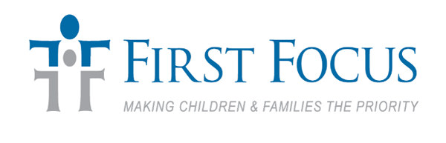
Federal budget and tax policy for children’s advocates
PRESENTED BY

Slide 2
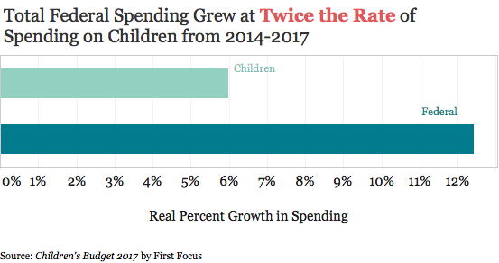
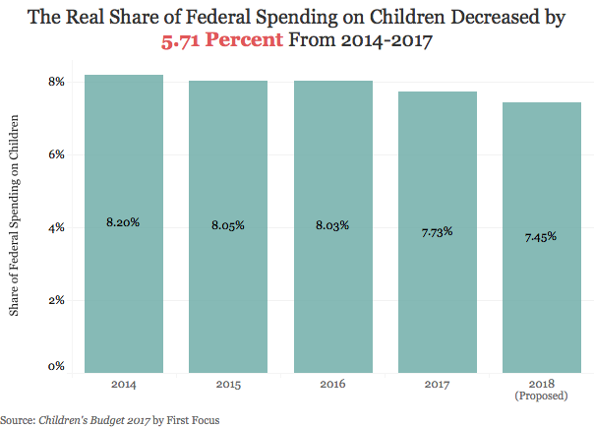
The Big picture: declining federal investment in children

Slide 3
The Federal budget
Discretionary Spending: Congress decides annually (appropriations process)
Non-Defense Discretionary (NDD) Spending
Mandatory Spending: Automatic (no annual review)
Defense Discretionary Spending
Social Security, Medicaid, Medicare, etc.
Notes:
Source: https://www.cbpp.org/research/policy-basics-introduction-to-the-federal-budget-process

Slide 4
Discretionary spending
Top-Line Number: 302(a)
Defense
Non-Defense (NDD)
Sub-allocation: 302(b)
Amount of money each appropriations subcommittee gets to spend
Line-item
Amount of money each subcommittee designates for a specific program
Roughly 1/3 of the total Federal budget

Slide 5
How the process is supposed to work
President's Budget Request
First Monday in February
Congressional Budget Resolution
April 15th
Annual Spending Legislation
New Fiscal Year
October 1st
Sets Top-line Spending Levels
House and Senate write and vote on 12 Appropriations bills
Reconciled versions pass by September 30th
Agencies know how much money they have and how to spend it

Slide 6
How It actually works
President's Budget Request
Congressional Budget Resolutions
Annual Spending Legislation
New Fiscal Year
All 12 bills don’t pass by deadline
Leads to government shutdowns or Continuing Resolutions (funding level remains the same as last fiscal year)
Agencies can’t plan, address growing needs, or operate at all if there’s a shutdown
Leadership ends up having to negotiate top-line spending levels
Used as vehicle for other legislative goals
Doesn’t have up-to-date information
Reasons for the Dysfunction
House and Senate can’t agree (partisanship)
Appropriators are constrained by the Budget Control Act of 2011(BCA)
Set limits, or caps, on discretionary spending
Automatic across-the-board cuts if spending exceeds caps
Gridlock: lawmakers attach controversial policies to spending bills

Slide 7
Investing in the whole child (Fiscal year 17 numbers)
Labor, Health, and Human Services (HHS), Education
$161 Billion
Agriculture
$20.9 Billion
Transportation, Housing, and Urban Development
(T-HUD)
$57.7 Billion
Commerce, Justice, Science
(CJS)
$56.6 Billion
5 discretionary programs serving children
$64 Million
110 discretionary programs serving children
$61 Billion
9 discretionary programs serving children
$6.8 Billion
5 discretionary programs serving children
$9.9 Billion
NDD Funding Cap under BCA: $519 B

Slide 8
How it hurts kids
NDD Spending hugely important for children’s programs, many of which are underfunded
80 percent of programs in Children’s Budget 2017 are NDD funded
When the overall pie isn’t big enough, children's programs are pitted against each other
Perpetual uncertainty in budget process makes it harder to effectively plan and provide services to kids and families

Slide 9
Other threats to children’s programs: mandatory cuts
Mandatory programs are funded outside of the annual appropriations process, but this doesn’t mean they are protected from cuts
  For programs that aren’t permanently funded, Congress can let authorization expire (see CHIP, MIECHV)
  Congress and/or Administration can impose restrictions that reduce access and overall funding (work requirements, citizenship requirements, etc.)
Impact of tax bill on deficit→cuts to mandatory programs

Slide 10
Current climate
Congress has passed 5 Continuing Resolutions since the start of FY 18
Impact on programs, agencies
Bipartisan Budget Agreement
Commitments to funds for opioid crisis, childcare development block grant
Current CR expires March 23rd
Ongoing negotiations around policy riders
Passed Feb 9th
Increased BCA Caps
Possible individual tax fix
FY 2018
FY 2019

Slide 11
General Children’s budget Talking points on the hill
Increase discretionary spending caps
  Any increase in defense discretionary spending caps should have commensurate increases in NDD spending caps (“parity” principle)
Ensure key appropriations subcommittees serving children get a big enough share of that funding so that no kids’ program is increased at the expense of another
Support mandatory programs that help vulnerable children and families afford basic needs including food, housing, health care and income security

Slide 12
Tax cuts and jobs act
Missed opportunity for pro-family tax policy
Harmful provisions to kids and families:
  $1.5 trillion estimated effect on deficit
  Child Tax Credit Social Security Number requirement
  Repeal of State and Local Tax deduction could hurt schools, hospitals
  Individual provisions expire in 2023, corporate provisions permanent

Slide 13
Contact info/resources
rachelm@firstfocus.org
President's FY 19 Budget Request on Kids
Children’s Budget 2017
Family Tax Policy: A Path Forward to Lifting Children out of Poverty
First Focus Campaign for Children Statement on Tax Cuts and Jobs Act

