Slide 1
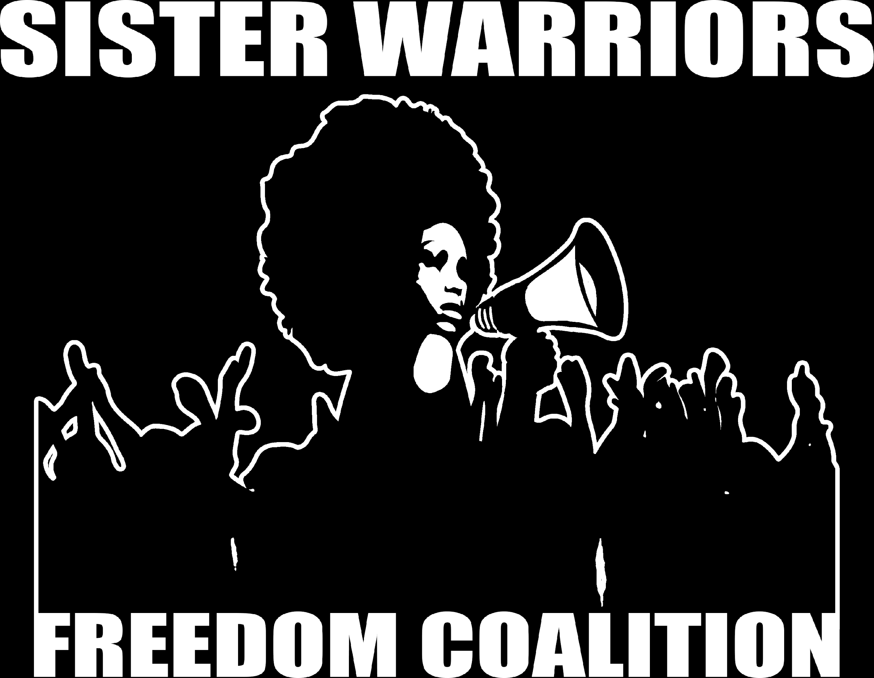

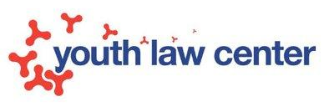
Ending the Criminalization of Poor
Women and Girls of Color
Presented By

Slide 2
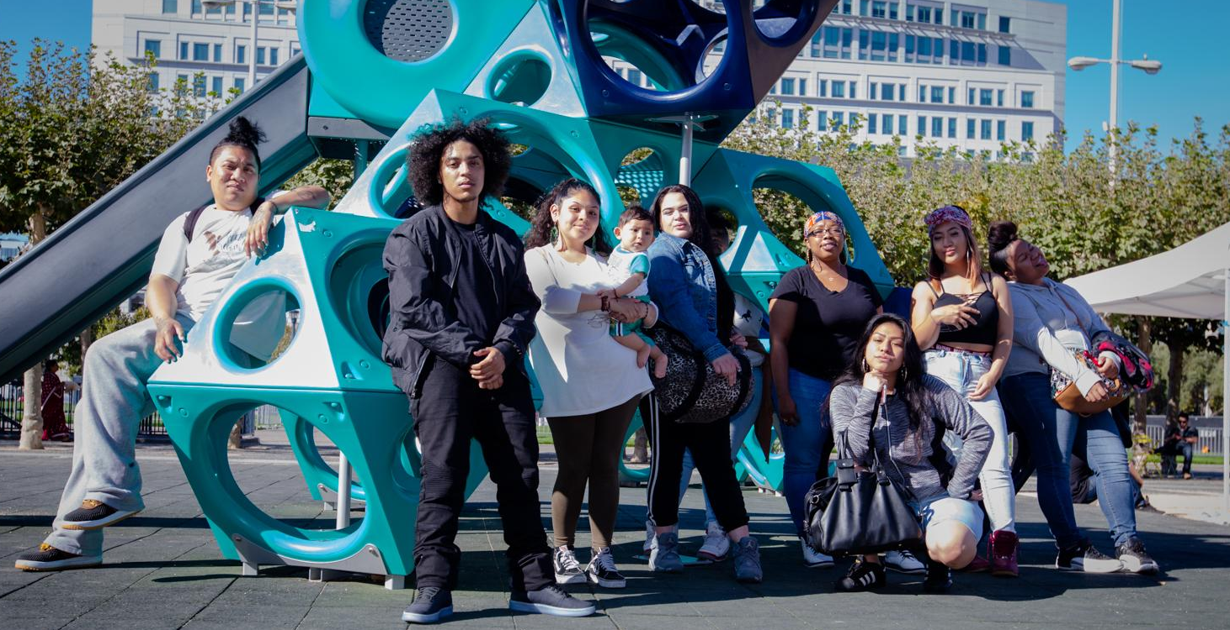
Working to decriminalize and decarcerate
young women, girls and TGNC folks for over 25 years

Slide 3
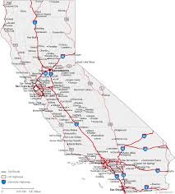
Decriminalizing and Decarcerating Women, Girls, and TGNC people in California.
#Freedom2030
Base Building
Place Based Strategy
Statewide Policy
Research
Movement-Based Legal Advocacy
#2BFREE

Slide 4
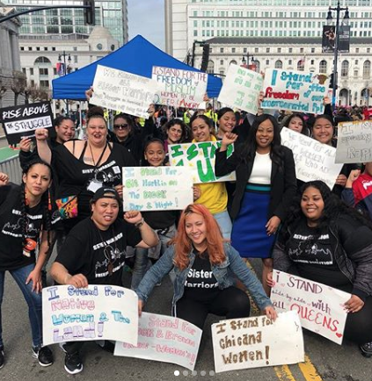
Movement Building
400 active core members across CA
Deep Partnerships: Essie Justice Group, CCWP, LSPC,
Engagement strategies with allies

Slide 5
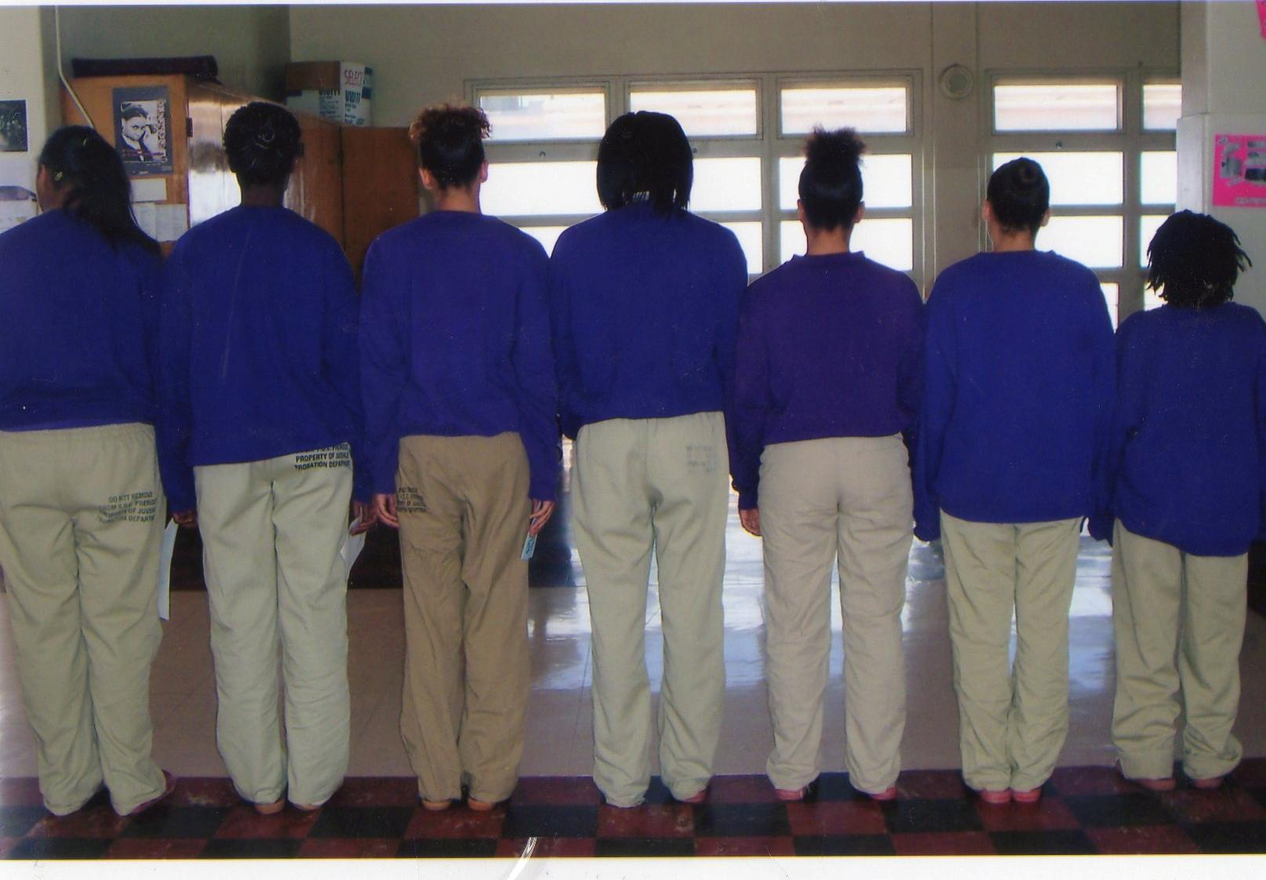
Place Based Strategy
Replicable Models for Transformation
Divestment + Investment Strategies
Led by those most Impacted
Ending Incarceration of girls in Santa Clara County

Slide 6
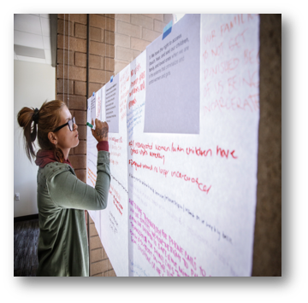
Launching Research Model
New Report for Research Institute
2-year statewide research project

Slide 7
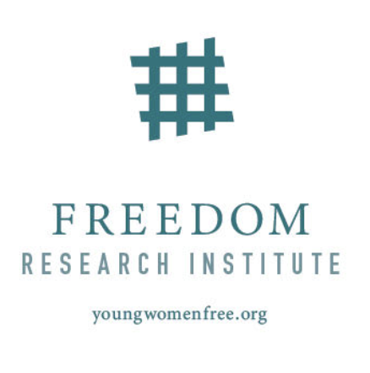
YWFC Center Research Model
Participatory
Community based
Decolonizing
Ethical

Slide 8
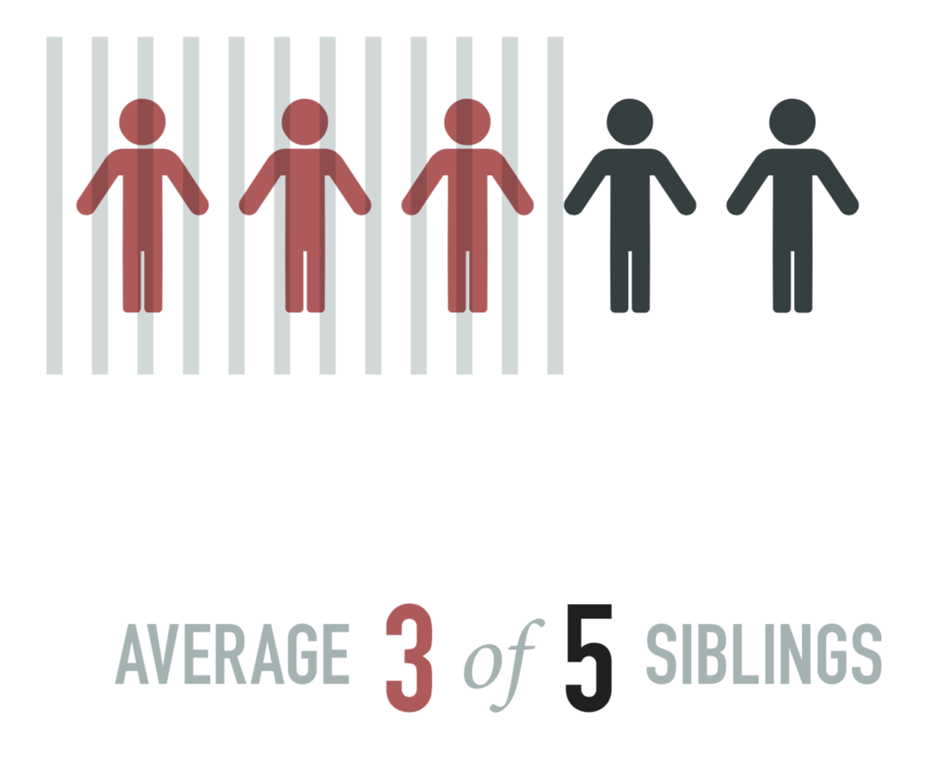
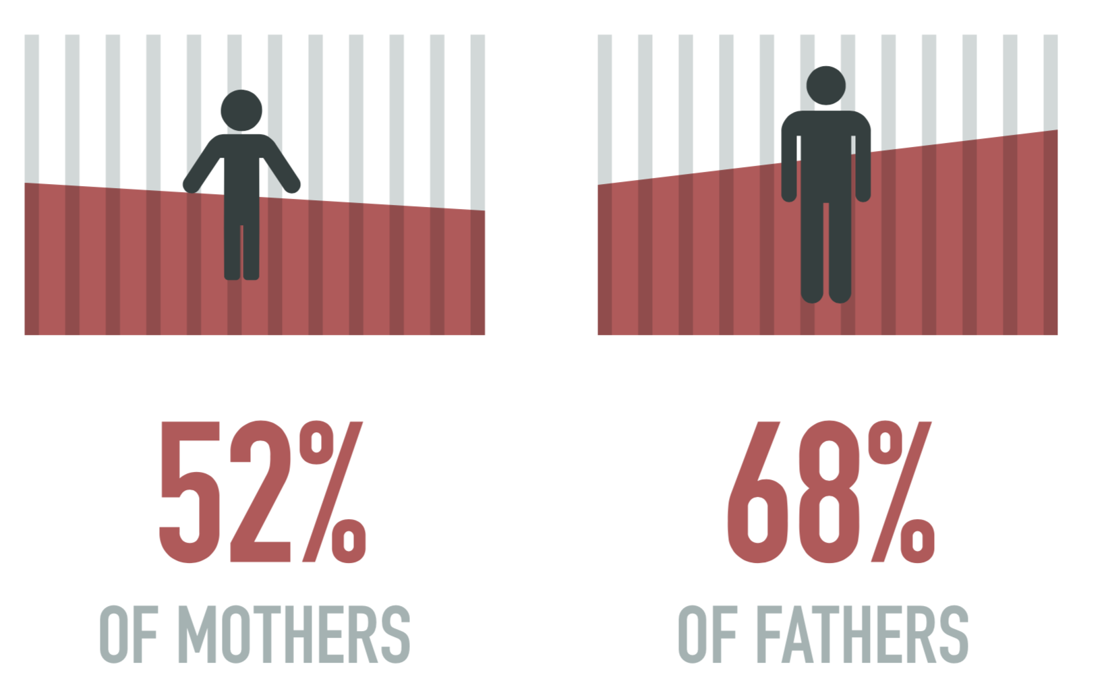
Family Incarceration
“I just think about the time that they were able to remove my dad, and then they were able to remove myself. That's my intro to systems, it's like-- You can’t even have your own living space. They could just straight up go in your house, knock down your door. That's what it means to be impacted to have things ripped apart.”

Slide 9
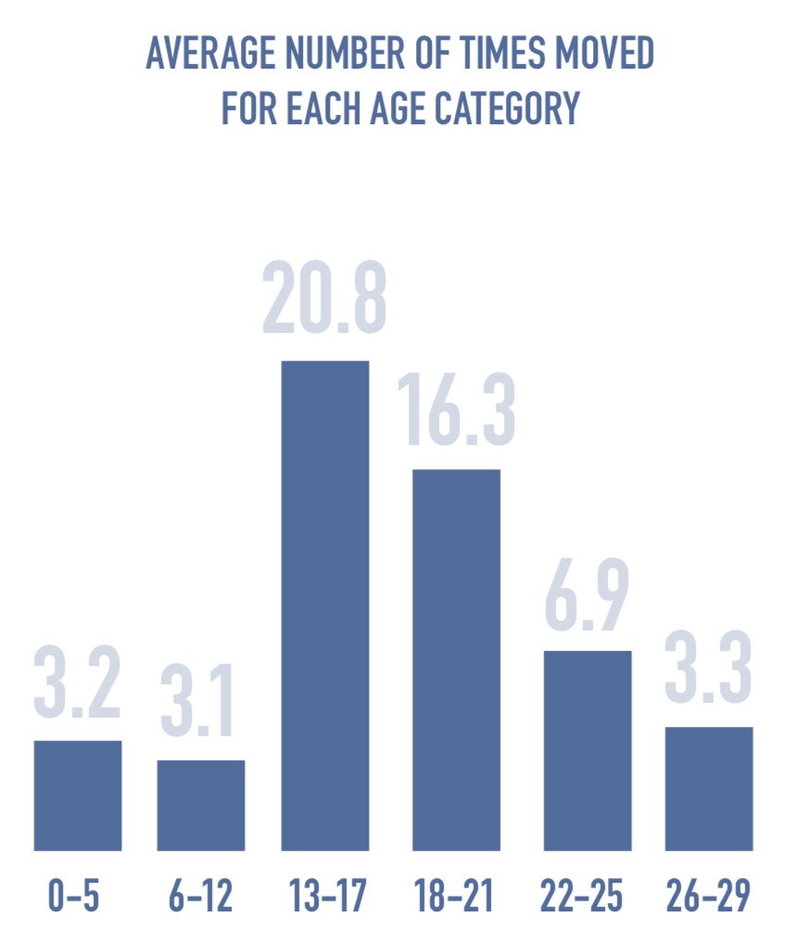
Housing Histories
“They just want to clean the street, but homeless doesn't always look like that. Homeless is, "I'm eight months pregnant, working full time, living in my car. There's different types of homeless.”
“It's not fun being displaced routinely. It's really not.”

Slide 10
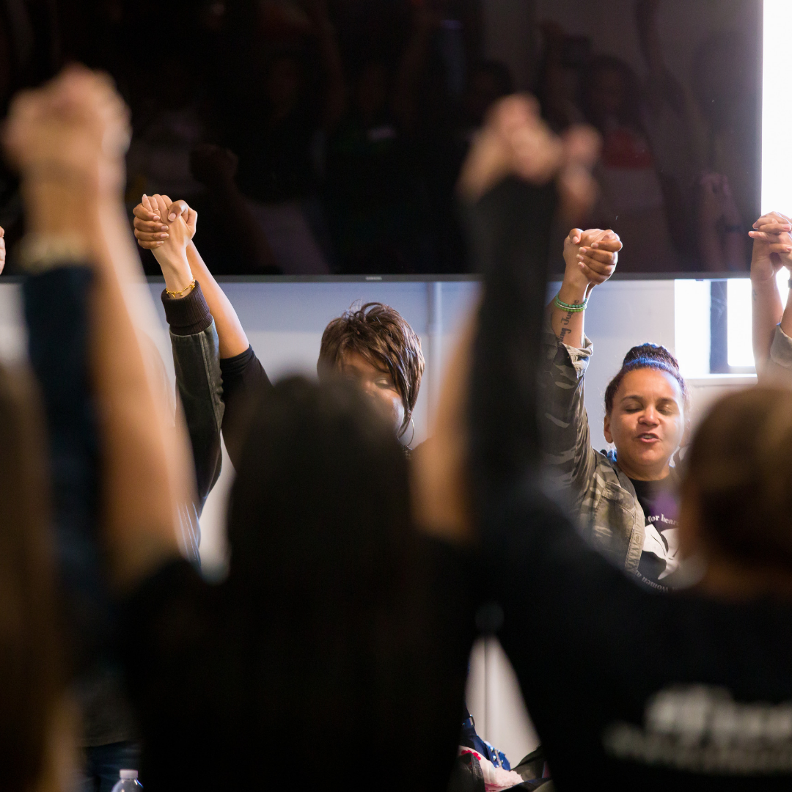
Movement-Based Legal Advocacy
Primary goal = Shifting power
Impact Litigation as a core tool
Legal analysis, research, legislative drafting, advocacy support
Framework = Challenging the Criminalization of Childhood

Slide 11
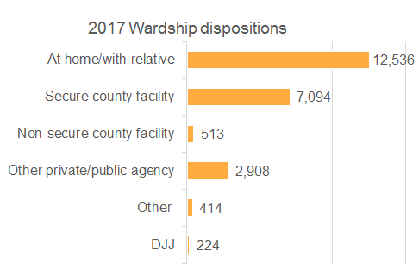
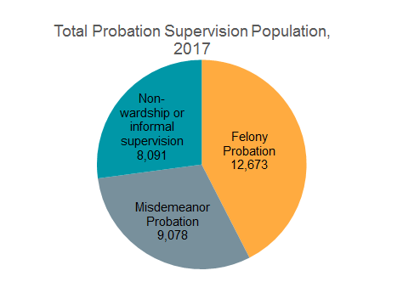
Challenging the Criminalization of Childhood
Over 23,000 cases resulted in probation supervision or custody in 2017
Most youth on probation are under misdemeanor or “informal” supervision.

Slide 12
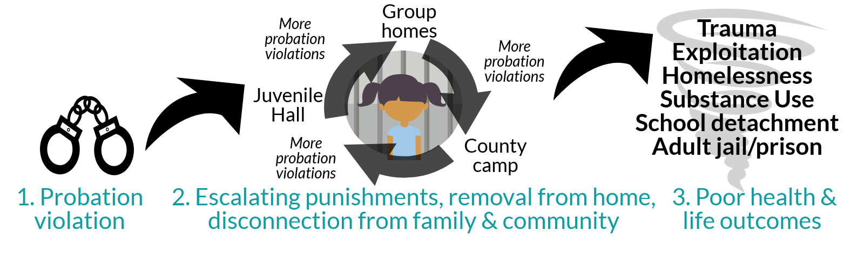
Challenging the Criminalization of Childhood
8,111 bookings into juvenile hall for probation violations in 2017
20% of youth in institutional placements are there for technical probation violations

Slide 13
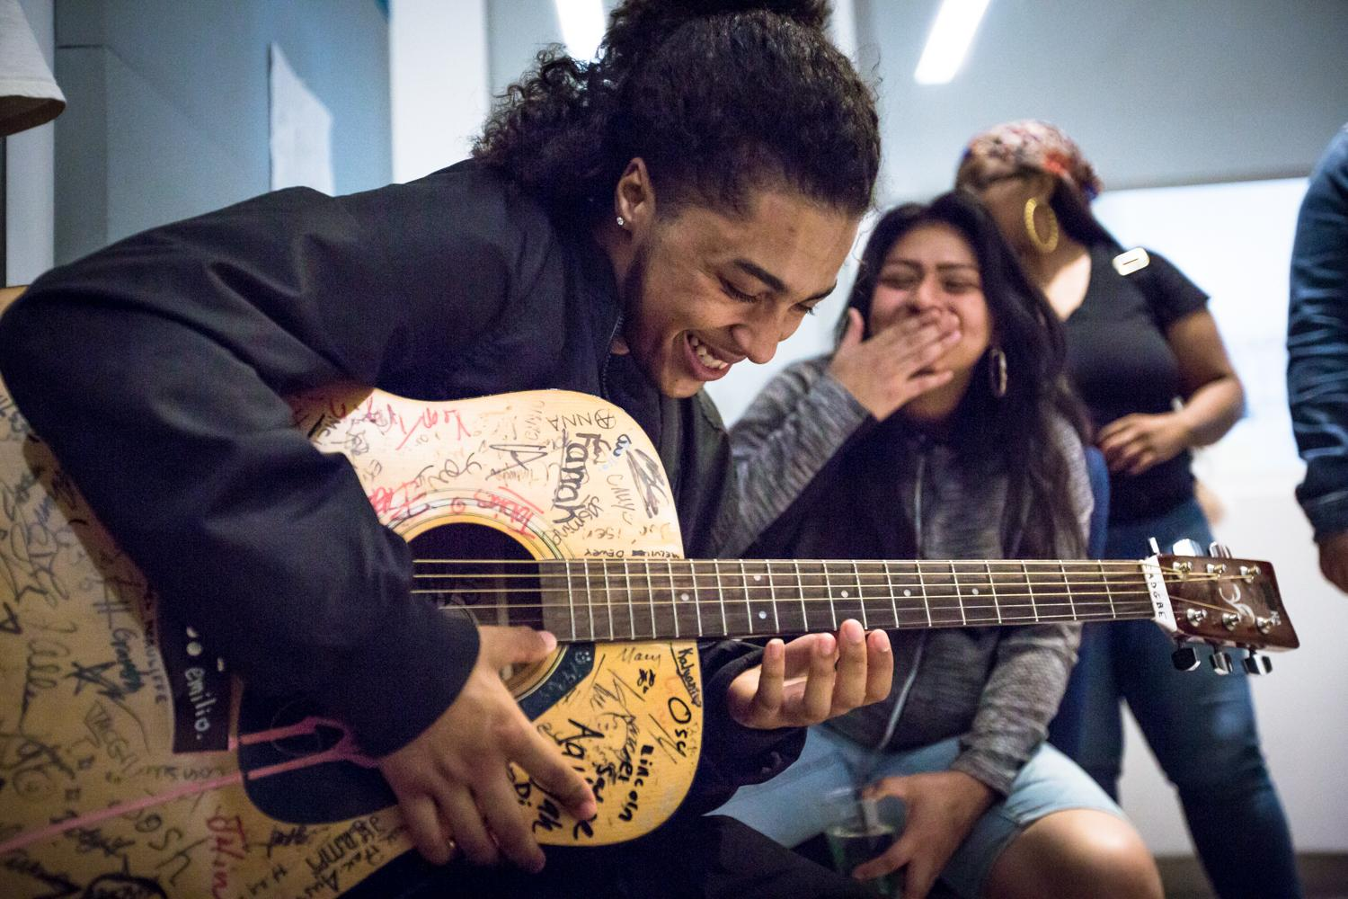
Movement-Based Legal Advocacy
Legal Advocacy to Restore Childhood:
County-based
Litigation-focused
Multi-disciplinary
Integrated with the movement
Advocacy Goals:
Protect fundamental rights;
Challenge surveillance and incarceration;
Demand community-based supports for youth.

Slide 14
Decriminalizing and Decarcerating Women, Girls, and TGNC people in California.
#Freedom2030
Base Building
Place Based Strategy
Statewide Policy
Research
Movement-Based Legal Advocacy
#2BFREE

