Slide 1
Trauma informed practices for schools - TIPS
Michelle Lustig, Ed.D, MSW, PPSC
San Diego County Office of Education
Foster Youth Services Coordinating Program & Homeless Education Services

Slide 2
OBJECTIVES:
Trauma Informed Practices In Schools
Prevalence & Response -Why does this matter?
Triggers – Why is this happening?!
Tools – What can I do?!
Self Care – This is exhausting….

Slide 3
WHY THIS MATTERS ….
  Adverse Childhood Experiences (ACE)-study
  http://www.cdc.gov/ace/index.htm
  Kaiser Permanente, San Diego, CA
    Original 286 patients
    17,000 participant sample
  Participants completed a 10-question ACE Survey
  Something happens between infancy and adulthood to create a lifetime of addictions, abuse and mental health issues. (Dube et al., 2003)
Notes:
Dr. Felitti @ Kaiser – obesity clinic
Those who were most likely to drop out were those who were successfully losing weight. Digging more deeply with a study of those 286 patients learned that they had unconsciously using obesity as a shield against unwanted attention, or as a form of defense … that many of them had been physically or sexually abused.
*That which is conventionally viewed as a problem, was found to be the unconscious solution to other more serious problems. Many of these patients had also used tobacco, alcohol and street drugs to moderate stress…
Dr. Anda @ Centers for Disease Control – looking at psycho social origins of health related behaviors.
Teamed up to do a large scale study that could not be ignored. Study of the influence of stressful and traumatic childhood experiences on the origins of behaviors that underlie the leading causes of disability, social problems, health related behaviors and causes of death in the US. Largest study of its kind ever conducted.

Slide 4
Of The 17,000 Respondents…
Two-Thirds reported at least one ACE:
Physical, emotional or sexual abuse
Emotional or physical neglect
Growing up in a household where someone was an alcoholic, drug user, mentally ill, or suicidal
Family violence
Incarcerated family member
Notes:
Description of the ACE score… 10 item checklist of traumatic events (generally around those areas listed on the slide).
*In most cases not just one, but several of these ACEs existed in the child’s home.
2/3 of respondents reported at least one ACE…
ACEs were not only unexpectedly common but they were found to be cumulative – as the ACE score increased the chances of being a user of street drugs, tobacco or problems with alcohol also increased.
Risk factors for all major leading causes of death were all increased by ACEs

Slide 5
Additional Adverse Experiences
Loss of a loved one
Accidents
Homelessness
Community/School violence
Witnessing of domestic violence
Man-made or natural disasters
Terrorism
War
Notes:
The ACE study looked at a specific set of events however, there are additional types of traumatic events that occur in children’s lives that have the same effect. Other examples on the slide…
We live in a large military community – deployments, critical or fatal injuries of parents, etc.
Wildfires
Parent with cancer/chemotherapy/terminal illness…
ETC

Slide 6
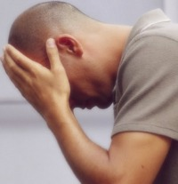
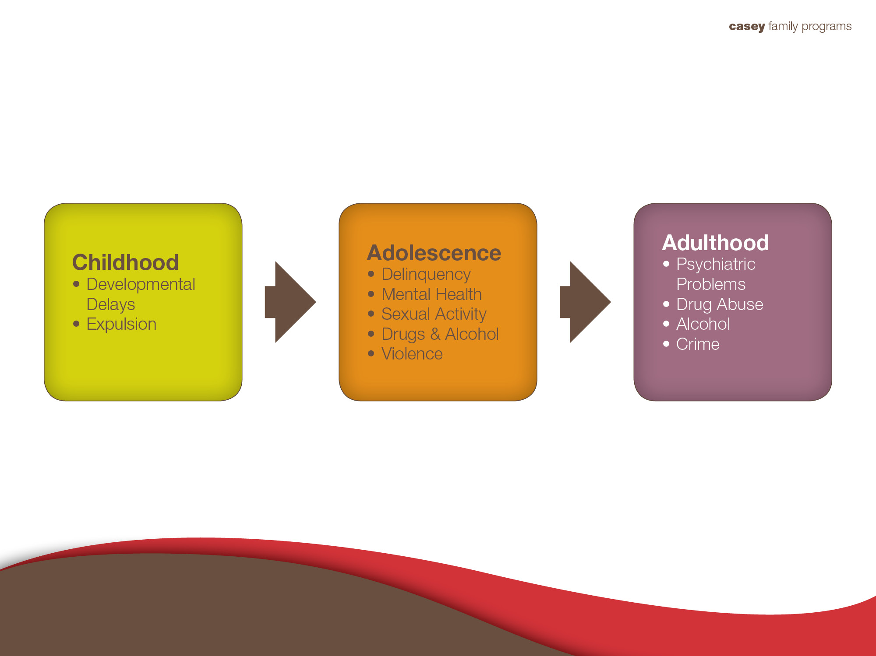
Untreated Adverse Early Childhood Events Only Exacerbate Over Time
Source: Adverse Childhood Experiences (ACE) Study.
Information available at http://www.cdc.gov/ace/index.htm
Notes:
The ACE Study makes one of the most compelling cases for addressing early trauma in that we now know that untreated adverse early childhood events don’t just go away on their own; but rather will only exacerbate over time if untreated.
Childhood: Untreated trauma can also manifest in developmental delays such as “not talking” or skill regression in which they can walk but they prefer to crawl. We also see this in the challenging behavior of young children in childcare who have been kicked out of multiple centers for unprovoked aggression, which for many is really a cry for help for their unmet emotional needs.
Adolescence: may manifest itself in more destructive ways. Studies of delinquent teens have found that many have ACES of 4-10. Researchers from Northwestern University recently gave psychiatric evaluations to more than a thousand young detainees at the Cook County Juvenile Temporary Detention Center in Chicago and found that 84 percent of the detainees had experienced two or more serious childhood traumas and that the majority had experienced six or more. More than 40 percent of the girls had been sexually abused as children. More than half of the boys said that at least once, they had been in situations so perilous that they thought they or people close to them were about to die or be badly wounded.
Source: How Children Succeed: Grit, Curiosity, and the Hidden Power of Character by Paul Tough, p. 26
References: Karen M. Abram et al., “Posttraumatic Stress Disorder and Trauma in Youth in Juvenile Detention,” Archives of General Psychiatry 61 (April 2004).
Roseanna Ander, Philip J. Cook, Jens Ludwig, and Harold Pollack, Gun Violence Among School-Age Youth in Chicago (Chicago: University of Chicago Crime Lab, 2009).
Adults: manifest in destructive physical and mental health. One study found that 75% of women in psychiatric units had a history of early abuse. Similarly with substance abuse, many have unresolved early adverse experiences which they have numbed or self medicated with drugs and alcohol.

Slide 7
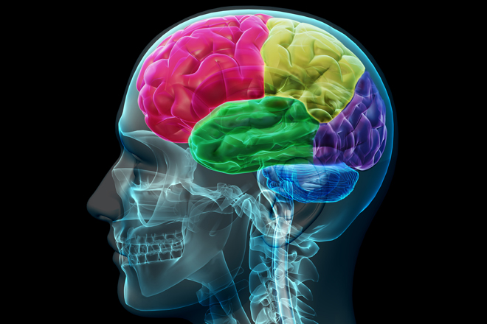
OUR BRAIN’S TRIO
Amygdala – Brain Stem
The NOW.
Am I safe?
Limbic system – Mid Brain
The PAST.
Memories, emotions, past hurts & experiences.
Can I trust you?
Pre-frontal cortex
The FUTURE.
Higher level functioning
can plan & consider consequences
Rational Thinking/Logic
Notes:
Brief neurological overview to understand trauma:
There are 3 important functions of the brain to understand related to trauma:
Amygdala or Stem – only interested in the NOW, am I safe now? Fight/Flight.
Limbic System or Mid Brain – focused on the PAST, bases decisions on past experiences, I have been hurt before therefore I cannot trust you. Relationships/Connection.
Pre-frontal Cortex (Neo-Cortex) – able to think in the FUTURE, this zone is responsible for higher level functioning, is able to create and execute plans for the future, considers future consequence. Thinking/Logic.
When we work with people dealing with trauma, often they come into our office/school/area using their amygdala, scanning to see if they are safe in the here and now, or the limbic system, being cautious of us. Overactive amygdala part of their brain – can look like aggressive, resistant to services, disconnected from others, constantly running away, freezing when confronted, lying, using substances for coping, etc.
WHEN AMYGDALA IS OVERACTIVE
TURNS OFF THE LIMBIC SYSTEM AND PREFRONTAL CORTEX – BECOMES INACTIVE
If we do not first address the needs of the amygdala and the limbic system, we will not be successful at targeting the pre-frontal cortex to develop plans for the future. Pre-frontal Cortex is where learning happens…

Slide 8
Historical Trauma
Evidence of post-traumatic stress disorder across generations
Pregnant women impacted by the World Trade Center attacks on 9/11 who had PTSD from the event gave birth to babies with an elevated stress response and a hypersensitive stress axis.
Children of parents who survived the holocaust were found to have the same genetic changes to gene related to stress as their parents.
Children in both cases are more susceptible to anxiety, depression and even PTSD than those whose parent did not experience PTSD
Notes:
The role of epigenitics –our DNA can actually be passed down through generations making people more susceptible to the impacts of trauma especially in the absence of a “buffering relationship”

Slide 9
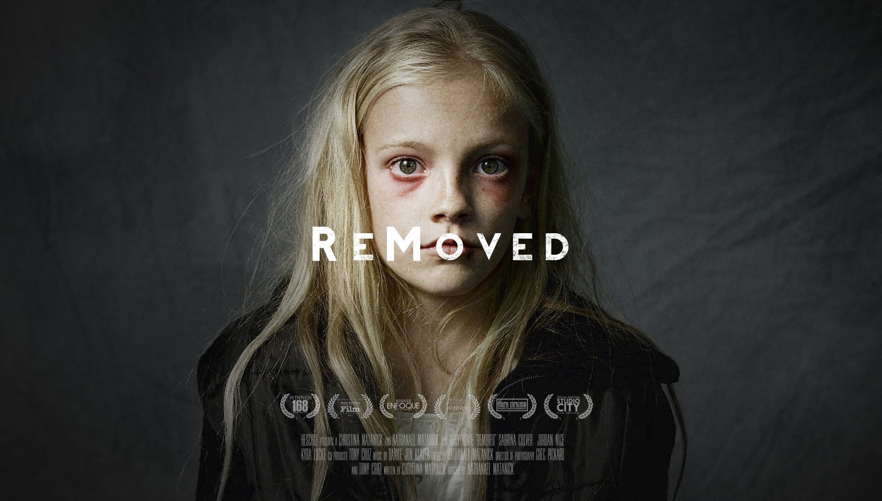
REMOVED Video

Slide 10
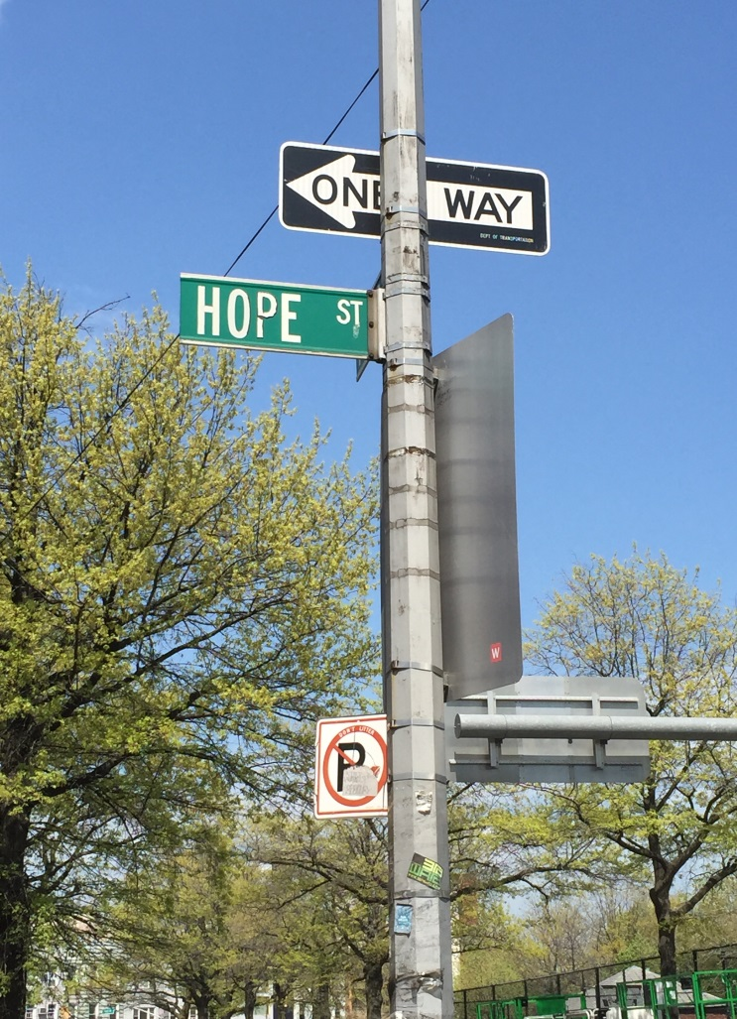
HOPE IS A ONE WAY STREET…
Resiliency is:
“The Deep Belief that at one time you really mattered to another human being”
      Vincent Feletti, M.D.
Notes:
In General: The responses of children are varied according to the relational supports in their lives…the resiliency factor is not so much “getting over it” or “bouncing back”, but more about the ability for relationships to buffer and heal trauma (more on that later in the ppt!). Dr. Vince Felitti (author of ACE study) defines resiliency as “The deep belief that at one time, you really mattered to someone”. The ability to heal and move beyond trauma is now known to be greatly influenced by the number and quality of supportive relationships in a traumatized child’s life.
THIS IS KEY. We all have the opportunity, no matter what our job or role at school, to be this person to a student. Susie’s bus driver story… Michelle – other mushy stuff ;)

Slide 11
WHAT IS TRAUMATIC STRESS?ic Stress?
Overwhelming experience
Involves a threat
Results in vulnerability and loss of control
Leaves people feeling helpless and fearful
Interferes with relationships and beliefs
“Trauma can be a single event, connected series of traumatic events or chronic lasting stress.”
Diagnostic Classification: 0-3R
Complex Trauma:
Multiple traumatic events, often that occur within a care-giving system that is supposed to be the source of safety and stability in a child’s life.
.
Notes:
Remember: There is a broad spectrum related to what is considered a “traumatic event”. Keep in mind that “trauma” is in the eye of the beholder, what may be traumatic for one person may not be traumatic for another. Universally agreed however, that proximity to the trauma (did it happen to you or did you observe it happening to others), frequency (one-time event vs. chronic), and severity of trauma will IMPACT the effect on the child. Notice the “involves a threat”– this may be a PERCEPTION or ILLOGICAL BELIEF on the part of the child, but the child believes he/she is threatened.
Single exposure to traumatic events may cause:
jumpiness,
intrusive thoughts,
interrupted sleep and nightmares,
anger and moodiness,
social withdrawal—any of which can interfere with concentration and memory
Chronic exposure can:
Adversely affect attention, memory, and cognition
Reduce a child’s ability to focus, organize, and process information
interfere with effective problem solving and/or planning

Slide 12
THE STRESS RESPONSE AND TRAUMA
The stress response is a chemical response
Prepares the body for action
  Fight
  Flight
  Freeze
Most recover.
Some develop more severe difficulties.
Notes:
The stress response is chemical and involuntary! This is Key
Student is in survival mode = prefrontal cortex is turned off, unable to reason or think about consequences before acting
On slide: “Varied responses” = as noted before in directly relation to supports, resiliency and complexity of trauma (all from earlier slides)
On slide: “some develop more severe difficulties” = ACE study tells us this!

Slide 13
TRAUMA AND SCHOOL PERFORMANCE
Traumatized children are:
  2.5x more likely to fail a grade in school
  Score lower on standardized achievement tests
  More likely to have struggles in receptive and expressive language
  Suspended and expelled more often
  More frequently placed in special education
  51% of children with 4+ ACE scores demonstrated learning and behavior challenges in school-Compared with on 3% of children reporting no score
      Source: Burke, N.J., Hellman, J.L., Scott, B.G., Weems, C.F & Carrion, V.C. (June 2011).
      “The Impact of Adverse Childhood Experiences on an Urban Pediatric Population,”
      Child Abuse and Neglect, 35, No. 6
Notes:
Point out “suspended and expelled more often”
Students who are suffering from and responding to triggers of trauma tend to be a magnet for school discipline (insert Susie’s semi-rant on traditional discipline;)) …*remember how what was conventionally viewed as a problem was the unconscious solution…? More on this coming up

Slide 14
TRIGGERS AND BEHAVIOR
Triggers include seeing, feeling, or hearing something that remind us of past trauma.
Triggers activate the alarm system.
When the alarm system is activated, but there is no danger, it is a false alarm.
The response is as if there is current danger.
The response in involuntary – remember the amygdala responds!
Notes:
Michelle’s favorite getting pulled over by the police example!

Slide 15
TRIGGERS AND BEHAVIOR
Some Common Triggers:
Sirens
Loud noises – school bell
Police Officers / Fire Persons
Schedule Changes
  Minimum Days, testing days, fire/earthquake drills, picture day…
Sights and Smells
Resemblances – physical and verbal
Terms of Endearment
Unexpected Touch
……. You tell us?
Notes:
Refer back to the video… places in the video where we might expect a trigger
the siren right before all the chaos starts
picture day
The big one… the dress example!

Slide 16
TRIGGERS AND BEHAVIOR
It can take time to realize you are dealing with a trigger.
Often involves knowing and being engaged with the student over time.
Often it is a response that doesn’t make sense in any other way.
Remember that student responses do not always match our expectation…
Example depression in children often looks like anger
Notes:
Disclaimer: we are not saying that every behavior is a response to a trigger. It is one possibility. Sometimes anger is just anger… I wanted an A and you gave me a C and I’m mad!
Also, it’s important to remember that in childhood responses to emotions don’t always look like what we think… for example, in adolescent boys it is very common for depression to look like anger or aggression.

Slide 17
WHAT IT MIGHT MEAN:
THIS…. MIGHT BE BECAUSE OF THIS..
Oppositional
Overly compliant
Outburst
Anger
Depressed
Argumentative
Rapid escalation
Avoid rejection
Avoid emotions
Built up
Deny hurt feelings
Anger turned inward
Test relationship
Heightened alarm system
Handouts: Working With Students Exposed To Trauma series
Notes:
Encouraging the audience to look beyond what they see in class or at school all the time in light of this information….

Slide 18
A PARADIGM SHIFT ….
Moving away from thinking about students in terms of
“What's wrong with you?”
to
“What happened to you?”
(Provides context, fosters compassion, helps to see strengths in face of adversity)

Slide 19
UNDERSTANDING THAT ….
TRAUMA EXPLAINS BEHAVIOR IT DOES NOT EXCUSE BEHAVIOR
Problem Behaviors are often due to
a desire to Self Protect or Mechanisms for Coping
Notes:
Behavior should still be dealt with… this paradigm allows us to do that more effectively if we understand where it’s coming from and with more compassion!

Slide 20
TO ADDRESS TRAUMA WE MUST ADDRESS THE S-C-S OF STUDENTS IN OUR SCHOOLS
Create a sense of-
SAFETY
Meaningful relationships or-
CONNECTIONS
Teach/Practice
SELF-REGULATION
Notes:
Three main keys to addressing trauma at school – we go into each of them more in depth on the next few slides

Slide 21
S-C-S SAFETY
Trauma results in a loss of sense of safety
Safety is a human beings number one priority
In schools focusing on creating both physical and emotional safety must be a priority
Emotional Safety is created by:
  Empowering Others
  Providing Choices
  Fostering Connections
  Opportunities to develop Genuine Relationships

Slide 22
ELEMENTS OF A SAFE SCHOOL SETTING
Safety: physical and emotional safety
Structure: predictable, consistent routines
Supervision: eyes, ears, proximity to students
Self-Regulation: model it/teach it
Sense of Belonging & Significance (Self-Esteem): “I can do this; I belong here”
Success-celebrate! In or out of the classroom
Notes:
I mention all items on slide and focus on Structure
Predictable routines are so important… reminder that most youth impacted by trauma do not like to be surprised or caught off guard.
Ask them to think about all the times the school day will be different for students:
Minimum days
Testing days
Picture day
Field trips
Fire drills
assembly

Slide 23
S-C-S CONNECTIONS
Children need to feel belonging & significance before we can really expect them to respond or care about our rules or limits
Healthy relational interactions with safe and familiar individuals can buffer and heal trauma related problems
Research shows social connectedness as a protective factor against maltreatment
Social milieu (safe environments): major mediator of trauma
Notes:
These things have all been said already in the training… this is a reminder – it is about creating connections that heal. We all have the opportunity!

Slide 24
CONNECTING
Connections are created by:
  Role Modeling
  Listening
  Being Present
  Respectful Interactions
  Genuine Interactions
Remember that connections must be built at all levels:
  Staff to Student
  Staff to Staff
  Student to Student
  Staff to Caretakers
Notes:
Creating connections is easiest by listening and being present: remember the bus driver story I told earlier… ☺
Respectful interactions: monitor your own reactions, be aware of your own triggers
Genuine interactions: a student who is in survival mode tends to have a very good “bs” monitor… be yourself, be genuine and honest! Builds trust.

Slide 25
BUILDING RELATIONSHIPS IN THE SCHOOL:
Give students a voice
Allow student input on decisions
Provide suggestions box
Use students names
Greet students in the hallway
Listen without judgment
Help them problem-solve ask open-ended questions to further conversation
Notes:
More examples of how to….
Review all… of particular note: Use student names! Using terms like “sweetie” or “honey” can actually be a trigger to a student who has been abused.

Slide 26
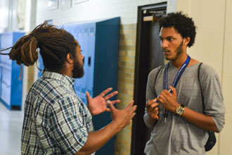
Don’t Quit on Me!
GradNation

Slide 27
S-C-S SELF-REGUALTION
Trauma impacts the way in which self-regulating skills are formed
Trauma directly influences how a student develops their coping skills
Schools that strive to build safe and nurturing schools where relationships are valued are more likely to promote and foster positive coping skills for their students
School based programs/paradigms that support TIPS:
  PBIS
  Restorative Practices
  SEL programs/2nd Step/Steps to Respect
  Developmental Assets
Notes:
We are going to talk about some ways to help students learn self regulation… this is much more possible when safety and connections are there! Self regulation skills are also supported by other practices that have become prevalent in school settings because of their effectiveness (as opposed to traditional forms of discipline) those programs listed on the slide.

Slide 28
“A child whose behavior is creating issues is not trying to cause a problem. They’re trying to solve a problem.”
American Journal of Pediatrics, November 1956
Notes:
Just another reminder…. They are not out to get you

Slide 29
EVERYTHING SPEAKS
Behavior is a form of communication
What is this behavior telling me about this youth? What is this youth trying to tell us through this behavior?
WHAT A STUDENT KNOWS AND HAS PRACTICED WILL ALWAYS FEEL THE MOST NORMAL
UNDERSTAND THAT:
That the student is not out to get us.
They act in a way that makes sense according to their understanding of how the world works.
See handout The Belief Behind The Behavior
Notes:
This slide speaks for itself mainly…. Show them the handout/chart I always encourage them to look more closely at it when they have time. It tells them how the student vs. the adult perceive situations and what the adult can change in order to be more effective! Isn’t that what we want?

Slide 30
STEPS TO BUILD AFFECT IDENTIFICATION
Build vocabulary
Connect emotions with:
  Body sensations
  Thoughts associated with feelings
  Behaviors—manifestations of feelings
Context
  External: Smells, Sounds
  Internal: Tired, hungry
Use literature, music, film to help kids learn to identify emotions.
See Handout, The Brain In The Palm of the Hand
Notes:
Go over the Brain in Palm of Hand lesson…. What it is/how it works
A lesson plan to explain what happens when we are triggered with a visual from the hand
Explains “flipping our lid”
Has students participate in creation of a safe space for someone flipping their lid within the classroom
Main reasons I love this activity and you will too:
It gives students a language to talk about what they already know they have been experiencing. A way to say what is going on that is non judgmental!
A way for everyone in the class to understand what is going on. Why do we usually send students who are having behavioral problems out of the classroom? Because it’s not fair to the other students… prevents me from teaching… This allows everyone to understand and participate without anyone having to leave. Yay!

Slide 31
MORE TIPS FOR TEACHING STUDENTS IMPACTED BY TRAUMA
Connections –
  “Two by Ten” Strategy - Handout
    R. Smith & M. Lambert, Assuming the Best
    85% Improvement in student behavior
    Behavior of all other students in class improved
    Often their worst student became an ally in the class
Notes:
Why I love the 2x10 strategy:
Here is where I tell the story about how I used it at the group homes…
This is an example of allowing a student to feel like they matter to you and how that drastically can improve behavior. 2 minutes of your time is nothing but being present for a student is SO MUCH!
It may seem counterintuitive, the students who seem to be deserving of punitive consequences are actually the ones who most need a positive and personal connection with the teacher. (this is what their behavior is telling us!)

Slide 32
MORE TIPS FOR TEACHING STUDENTS IMPACTED BY TRAUMA
Use and Teach what you know about trauma:
    Handouts: Working With Students Exposed To Trauma,
    Students who Don’t Perceive Safety
    Students Who Are Not Able To Self-Regulate Well
    Students Who Don’t Believe They Matter
    Students Who Don’t Succeed Academically or Socially
“Students often exhibit behaviors that are a result of trauma but that can be misinterpreted by a teacher as willful disobedience, or that the child has greater control over his/her behavior than he/she does.” Jody McVittie, MD, Sound Discipline
Notes:
The Working with Students Handouts:
We have heard from many school site personnel how useful/helpful these handouts are… each one is set up to tell you what trauma in the various situations may look like and is accompanied by things you can try as well as things you should definitely avoid.

Slide 33
MORE TIPS FOR TEACHING STUDENTS IMPACTED BY TRAUMA
Pay attention to the power of perception – or misinterpretation!
Handout: The Belief Behind The Behavior – A Key For Mistaken Beliefs
Five Underlying Goals and Effective Response Ideas:
Undue Attention
Special Service
Misguided Power (Control)
Revenge
Inadequacy or Avoidance of Humiliation (Anxiety)

Slide 34

“WE CAN’T TEACH WHAT WE DON’T KNOW. WE CAN’T LEAD WHERE WE WON’T GO.”
Malcolm X

Slide 35
Self Awareness..…
Educators and Empathy:
Empathy is the identification with or the experiencing of, the feelings, thoughts or attitudes of others.
Compassion Satisfaction: the positive feelings we get when we realize that the compassion we put in working with others is resulting in some relief, growth or healing.
Empathy is a double edged sword: It provides healing power, however empathy for the traumatic pain of another can result in personal upset or pain for the listener.

Slide 36
VICARIOUS TRAUMA
When empathy for a student’s suffering leads to internalizing or frightening realities not personally experienced we call this
vicarious (secondary) trauma
Constant demands to care for others may cause fatigue, emotional stress, or apathy. When trauma repeatedly overwhelms our ability to function normally we may experience compassion fatigue. High levels of compassion fatigue can, overtime lead to;
Burnout: physical and emotional exhaustion, involving the development of negative self concept, job attitudes and loss of concern and feeling for our students, their parents and our colleagues

Slide 37
THE PROFESSIONAL IMPACT OF VICARIOUS TRAUMA
(Adapted from The Heart of Learning and Teaching)
JOB TASKS
MORALE
INTERPERSONAL
BEHAVIORAL
PHYSICAL
EMOTIONAL
BEHAVIORAL
COGNITIVE
REALTIONAL (INTERPERSONAL)
WORLD VIEW (SPIRITUAL)
Notes:
Studies show that secondary traumatic stress is the leading cause of turnover among professionals who advocate for children
We think you should stay in your job ☺

Slide 38
SELF-CARE TECHNIQUES
PHYSICAL FITNESS
NUTRITION AND HYDRATION
SLEEP AND REST
ASSERTIVENESS
CENTERING AND SOLITUDE
CREATIVITY
FUN AND ENJOYMENT
CREATE A PLAN FOR SELF-CARE

Slide 39

QUESTIONS???

