Slide 1
Doctors in Dependency Cases

Slide 2
Use of an “Expert”
Definition
  “Anyone who knows more than I do”
  Artificial Intelligance
There to provide information
There to educate
Not there to advocate

Slide 3
Doctors
Medical Education
  Four years
  US schools vs. non US schools
Internship
  Become licensed after passing Part 3 of Medical Board
Residency
  Variable length of training
    Orthopedic Surgery 5 years
  Fellowship – additional training

Slide 4
Doctors
Board certification
  Not one national certifying board
  American Board of Medical Specialties
Continuing Medical Education
  Re-certification
  Maintenance of Certification

Slide 5
Doctors in Dependency Cases
What they are:
  Interpreters of the medical facts
  Trained Observers
  Schooled in Science, not law
    What “could” have happened, not what “more probably than not” did happen
  Medical Opinion
    Defined by the “basis” for that opinion
    “Basis” means facts / observations / interpretation of data

Slide 6
Doctors in Dependency Cases
What they are Not:
  Triers of fact
  Knowledgeable of legal terms
  Able to take sides
    Bias does not apply to data
  Able to extend opinion beyond set of facts
  Easy to deal with

Slide 7
Utilizing Doctors in Dependency Cases

Slide 8
How Doctors can Help
Identify / describe patterns of injury
  Fractures, burns, bruises, retinal hemorrhaging
Assemble a Timeline of injuries
  Need serial data points to be most specific
  Did injuries occur at the same time
  Using information from multiple sources
Put history of injury into context
  Could the injuries have occurred as described?
  Pointing out what doesn’t fit equally as important as corroborating history

Slide 9
Putting Patterns into Context
Childs age / weight
  Pediatrician charts important
Metabolic status
  Catabolic vs. Anabolic state
Congenital anomalies
  Clavicle, tibia congenital non-unions
Inheritable diseases
  Osteogenesis Imperfecta
Birth related issues
  Small for gestational weight
  Neonatal Ricketts

Slide 10
Collecting the Data
Primary Survey
  Collect data from first ER contact
  Records, Lab, X-rays / Images, scans
  Consultations
    Ophthalmology
    Neurology
    Neurosurgery
    Orthopedic Surgery
    Hematology
    Plastic Surgery (Burns)

Slide 11
Collecting the Data
Secondary Survey
  Repeat Skeletal Survey at 2 weeks
  MRI
  Bone Scan
  Operative Reports
  Follow up consultations
  OES 900 exams
  Patient
  Siblings

Slide 12
What Helps / What Doesn’t
Helpful
  Petition included
  Scans on CD include all studies
    Head CT – need bone “windows”
  Expert Opinion reports
  If less than 3 months old
    Birth Records

Slide 13
What Helps / What Doesn’t
Not as Useful
  Police reports
  Live Scans
  Prior NAT reports / allegations
  Social worker interviews with treating doctors
  Sibling medical records

Slide 14
Utilizing Experts
Report the facts
  Facts form basis of Opinions
    Differentiate actual from possible
      Secondary data key
Establish Timelines of Injury
  Clues to aging of injuries
    Callus formation – long bones
    Soft Tissue Swelling – skull fractures
    Bruise patterns of healing
      Purple to red to yellow / green

Slide 15
Utilizing Experts
Identifying patterns of injury
  SDH, retinal hemorrhaging, MCFs, posterior rib fractures
Explain Pathophysiology of Injuries
  Spiral fracture
  Transverse fracture
  Oblique fracture
  Tool marks
  Burns
  Bruise / hematoma / hemorrhage

Slide 16
Utilizing Experts
Interpreting Reports
  What data was used for the basis of the opinion(s)
  When was the report prepared
    Pre-secondary survey
  How was the data obtained
    First hand vs. second hand
    Did they actually review the films independent of another expert or not
    Primary source verification

Slide 17
Differentiating Experts
Sub Specialty
  Radiologist vs. Orthopedic Surgeon
Experience / Education
What was reviewed
  Primary source verification
  Reliance on records / consultations
Verify with secondary survey

Slide 18
Utilizing Experts
Building a case
  Series of opinions based upon interpretation of data sets
Pre Trial Opinion letters
  What was reviewed
  Opinions
  Basis for those opinions
If left untreated
  Disfigurement, Dysfunction, Deformity
  Death

Slide 19
Utilizing Experts
Trial Testimony
  Never a surprise
  Explain opinions / basis for opinions
  Never biased or judgmental
  Never combative
  Use props as necessary to make a point
    Posterior rib fractures
  Explaining x-rays / scans helpful to demonstrate depth of knowledge / understanding

Slide 20
Common Myths and the Truth

Slide 21
Myths
Certain injuries are “classic” for non accidental trauma
  Patterns can be characteristic of NAT
  Individual injuries are rarely characteristic
Need to understand “Classic” or “path gnomonic” signs of abuse

Slide 22
“Classic” Fractures
Non-Accidental Trauma
Metaphyseal Corner Fractures
  Distal femur / Proximal tibia
Rib fractures
  Bilateral, posterior paraspinal
  Ribs 4 to 9 most common
  4 or greater “high risk” of death
Spiral Fractures
  Humerus / Femur
  Distal part of spiral points to direction of twist
Skull Fractures
  Parietal most common
  Epidural hematoma vas subdural hematoma

Slide 23
“Classic” Fractures
Non-Accidental Trauma
Metaphyseal Corner Fractures
  “Classic metaphyseal lesion”
  End of the bone
    Adjacent to the growth plate
Described by PK Kleiman, MD 1986 article
Significant debate about callus formation
  Up to 1/3 – no callus

Slide 24
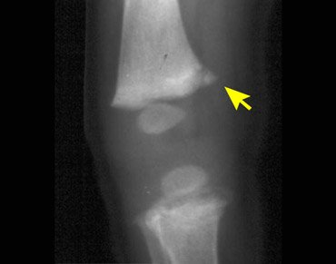

Slide 25
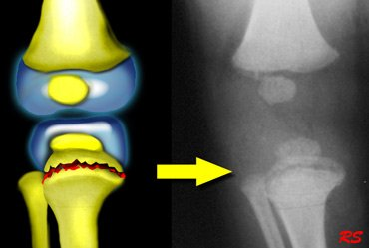

Slide 26
“Classic” Fractures
Non-Accidental Trauma
Rib fractures
  Posterior versus lateral
    Squeeze versus direct trauma
    Anterior posterior force versus lateral compression
    Clavicles are protected
May be very hard to see initially
  Usually picked up in the healing phase
4 or more are associates with significant chance of death

Slide 27
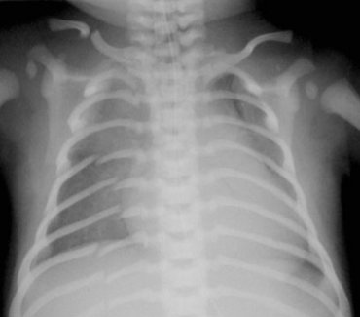

Slide 28
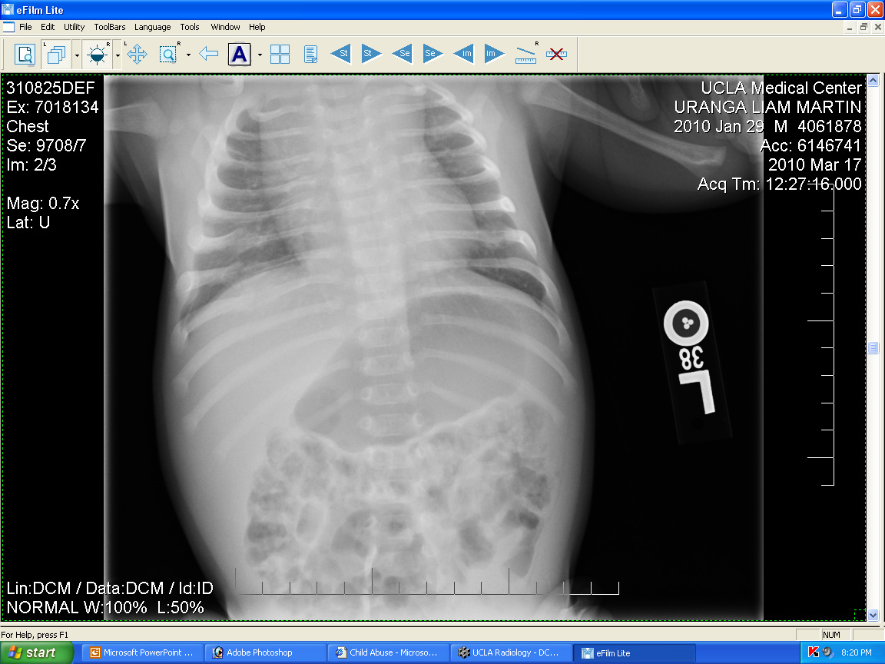

Slide 29
“Classic” Fractures
Non-Accidental Trauma
Spiral fractures
  Fracture morphology is related to how the force is applied
  Transverse fractures are bending moments of force
  Spiral fractures are rotational moments of force
Oblique fractures are a combination of the two

Slide 30
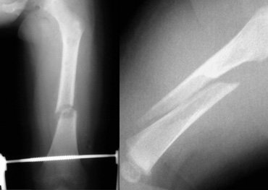

Slide 31
“Classic” Fractures
Non-Accidental Trauma
Skull fractures
  Heaviest part of a baby
  Parietal fracture is most common
  “too many lines sign”
    Have to differentiate from normal skull sutures
Overlying hematoma is best way to date fracture
  Galeal fascia (scalp) overlies the skull
  Swelling maximal in 24 to 48 hours, gone in 5 to 7 days
  Look for tool marks

Slide 32
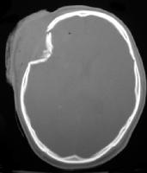

Slide 33
Brain Hematomas
Three layers of the brain
  Dura Mater
    Thick outer covering
  Arachnoid Mater
    Thin “spidery” layer
      Lots of blood vessels
      Can have spontaneous hemorrhage
  Pia Mater
    Thinnest layer
    Most Delicate

Slide 34
Brain Hematomas
Epidural Hematoma
  Outside the dura, beneath the skull
    Frequently associated with skull fractures (parietal)
    Common with being dropped
      Outside in trauma
Subdural hematoma
  Beneath the dura
    May become Hygroma (fluid tumor)
    Associated with acceleration / deceleration
    May be acute or chronic
    May be caused by meningitis
Intra-parenchymal bleed
  Within the brain
  Causes scarring / long term lesions

Slide 35
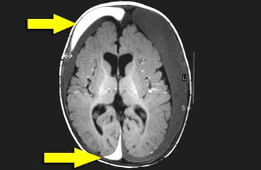

Slide 36
Shaken Baby Syndrome
Association of Shaking / Squeezing
  Subdural hematoma
  Retinal Hemorrhages
    Other etiologies – meningitis, CPR
  Symmetric posterior Rib fractures
  Associated with Metaphyseal Corner Fractures
  Blunt abdominal trauma
    Look for elevated enzymes
Specific pathologic entity – first described in 1972
  60% involve boys
  Most common under 1 year of age
Need to rule out bleeding disorder
  Factor XII, Factor VIII

Slide 37
“Classic” Fractures
Accidental Trauma
Toddler’s Fracture
  Spiral fracture of tibia
  Intact Fibula
Torus Fracture
  Distal radius / tibia
Supracondylar Humerus fracture
  Extension pattern, transverse
Forearm mid-shaft fractures
  May be occult
  Both bones always involved

Slide 38
Cross Examination Tips

Slide 39
Cross Examination Tips
Obtain pre trial reports and have them reviewed for accuracy
  Identify opinions based on primary source verification versus reliance on other sources
Understand the basis for opinions at time of trial
  Expose gaps in theories
  In x-ray reports look to the “findings” section versus the “conclusion” section

Slide 40
Cross Examination Tips
Use checklist to make sure all available data is present
  Make sure secondary skeletal surveys were done
    If not, why?
    Use hypothetical to make points
  If rib fractures are subtle
    Was bone scan done?
  Metaphyseal Corner Fractures
    Can be confirmed by MRI

Slide 41
Cross Examination Tips
Do not dwell on “interpretation” opinion
  Attack basis for that opinion
  If the basis is false, opinion is not as strong
Focus on whole picture
  Identify and analyze patterns or specifically lack of patterns of abuse
  Rare that one injury denotes a pattern

Slide 42
Fracture 101

Slide 43
Fracture Healing
Bone is Alive
  Blood Supply from both intra-medullary and periosteal sources
Age determines metabolic rate
  The younger the patient, the faster the process
Consistent healing Pattern
  Stages of healing
  Acute versus chronic
  Allow aging of the fracture pattern

Slide 44
Fracture Healing
Acute fracture
  May or may not swell
Early Callous Formation
  Appears at 5 to 7 days
Mature Callus
  Fracture line disappears at about 4 weeks
Re-modeling
  May take years
    The younger, the better

Slide 45
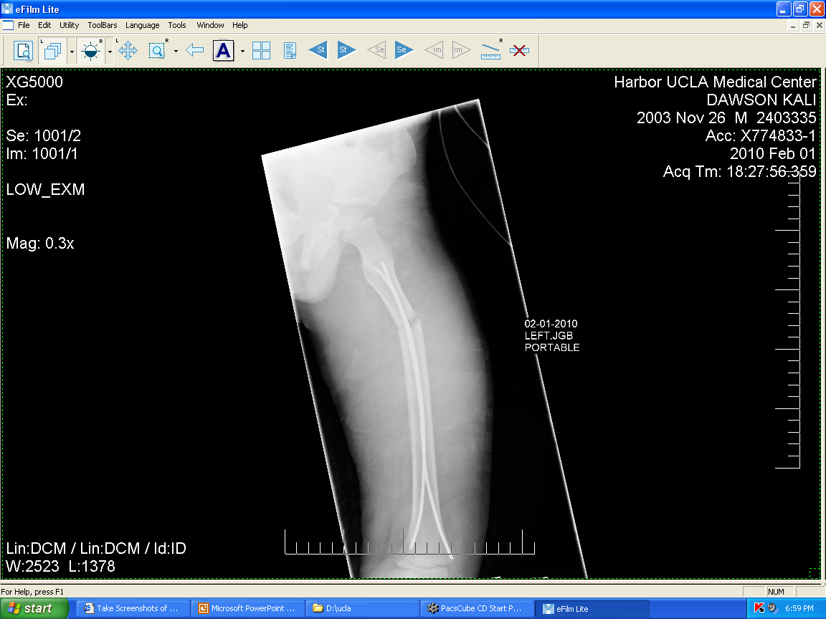

Slide 46
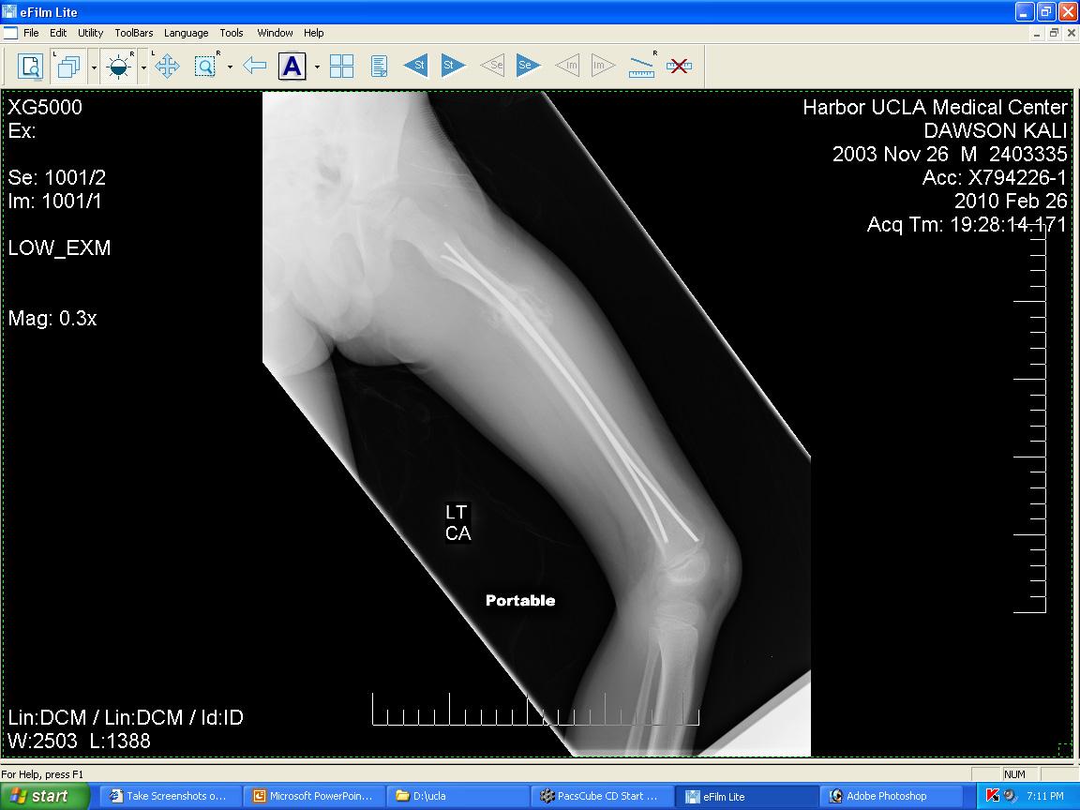

Slide 47
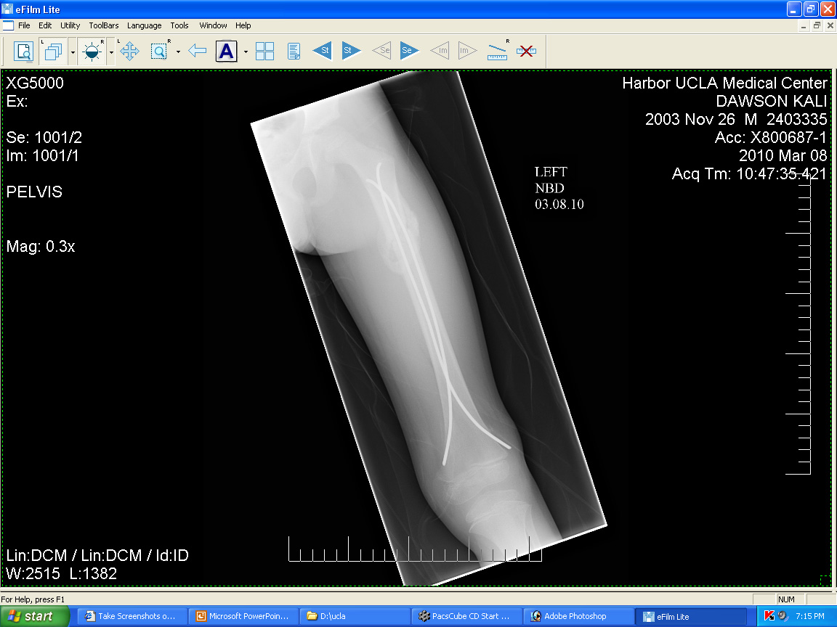

Slide 48
Bone 101
Children Grow through growth plates on the end of the bone
  Tube of tooth paste
Fractures remodel best at the ends of the bone
Angular deformities correct in the plane of the joint

Slide 49
Bruises
Caused by hemorrhage into the skin
  Small vessels rupture
  Can be caused by anything disrupting those vessels
    Petechiae – small punctate hemorrhages
      May be caused by emboli
    Can occur in internal organs
      Thymus gland in the neck

Slide 50
Bruises
Resolve by reabsorbtion
  Blood products brake down
    Porphyrins
      Blood pigments
  Blue to red to green to yellow
Able to date “loosely” by color
  Depends on metabolic status
  Depends on nutrition

Slide 51
Retinal Hemorrhages
Key link
  www.cincinnatichildrens.org/svc/alpha/c/child-abuse/tools/retinal-hemorrhage.htm
Bleeding involving small vessels at back of the retina
  Caused by increase / decrease in presure
  Can be unilateral
  Associated with traumatic brain injury

Slide 52
Retinal Hemorrhages
Can it be associated with accidental injury?
  Case reports of 3 children with household trauma
    Localized to the posterior pole
  215 children – 2 with hemorrhages
    Both in MVAs
Can be caused by CPR
  117 children examined – 9 positive
Not caused by seizures

Slide 53
Retinal Hemorrhages
Neonates – examined at 1 week
  Vacuum extraction higher than C section
  15% incidence
    Resolved usually in 1 week – can take up to 6 weeks
Purtscher retinopathy
  Ecchymosis of the chest associated with RH
Terson Syndrome
  Vitreous hemorrhage associated with sub arachnoid hemorrhage

Slide 54
Thank You

