Slide 1
California Coalition for Children’s Safety and Health (CCCSH)
&
California Unintentional Injury Prevention Strategic Plan Project
Overview and Childhood Unintentional Injury Legislation Update
For
CAI Children’s Advocates Roundtable
May 9, 2019
By
Catherine Barankin, Executive Director CCCSH
Project State Co-Chair & Program Director
Co-Chairs CA Unintentional Injury Prevention Strategic Plan Project
cbarankin@aol.com and scbarrow88@gmail.com

Slide 2
Presentation Overview
What is CCCSH
What is CA Unintentional Injury Prevention Strategic Plan Project
Eight leading Unintentional Injury Issue areas of focus
Why we do this
How Project is organized
Who are the project stakeholders
2019-20 Legislative Session Bills
Where help is needed
Contact information

Slide 3
What is CCCSH
Non-profit created in 1991
Coalition Goal, Vision and Mission:
  End Unintentional Injury’s Reign as the leading cause of death and hospitalization for CA’s children and youth through age 19 years old
CCCSH moves children’s safety and health forward by advancing local solutions and statewide policy, linking people and resources, and removing barriers to successful outcomes.

Slide 4
CA Unintentional Injury Prevention Strategic Plan Project
Unintentional injury leading cause of death and hospitalizations for CA’s children and youth through age 19 years old
Project Goal is to end unintentional injury’s reign as leading cause of death and hospitalization for CA’s children and youth
In CA 1,000 children Die a year die due to UI – equivalent to death of every child in 3 elementary schools each year
Another 24,000 CA children are hospitalized – equivalent to putting all children in 64 elementary schools in the hospital every year

Slide 5
Eight leading causes of unintentional injury
Traffic (Vehicle, Bicycle, Pedestrian)
Non-traffic (kids left in cars, driveway backovers, etc.)
Poisoning (RX, Lead, Toxic home products)
Burns (Home fires, kitchen)
Falls (window and furniture falls)
Drowning (pools and open bodies of water)
Suffocation (Primarily infant/Baby sleep suffocation)
Sports (concussion, heat stroke, cardiac arrest)

Slide 6
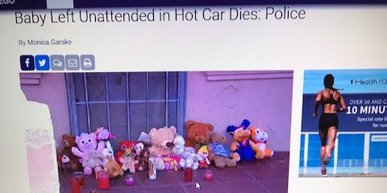
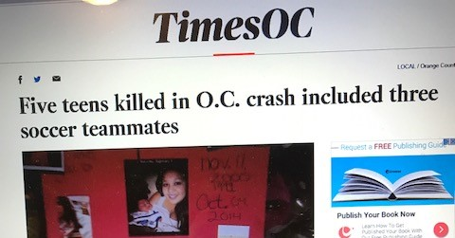
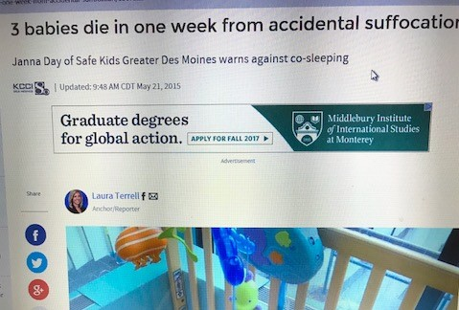
Why We Do This

Slide 7
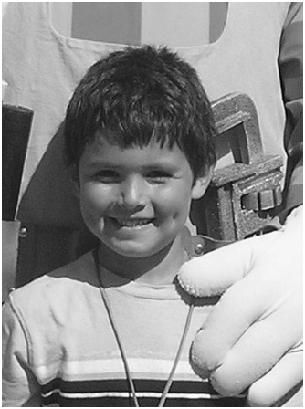
Why We Do This
Nicky.
On Father's Day, June 20, 2010, 5 year old Nicky, his sister, and their friends were playing outside. The older kids got bored and eventually wondered inside to play games and watch a movie. Unknown to Nicky's father, Nicky a neighbor friend went to her house where her mother was asleep. Somehow they ventured past a locked sliding door and a door alarm that was not connected and into the unprotected swimming pool without supervision. After a brief search, Nicky's father knocked on the neighbor’s door and the little girl answered the door saying "Nicky went swimming and I think he drowned.” He was pulled from the swimming pool by his father after an unknown time in the water. CPR was performed by another neighbor who heard all the screaming for help. First responders transported Nicky to the hospital, but he never regained consciousness. His parents’ lives have never been the same.
Nicholas Joseph Norman/ Age 5 /
San Diego CA
Backyard pool

Slide 8
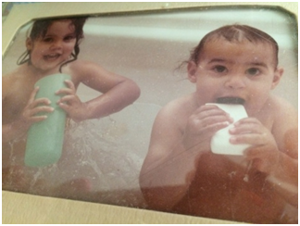
Why We Do This
Samira and JJ.
Samira was two years old and JJ just 14 months old the day they slipped through a sliding door and out of sight of their babysitter. A few minutes later the babysitter found both of the children floating face down in the backyard pool. A neighbor helped provide CPR until the fire department arrived. Samira had no life signs and was not able to be resuscitated. JJ had a slight heart beat! He was resuscitated, but too late. JJ’s mom recently held a 40th birthday party at the institution where he is cared for. He is the oldest living near-drowning victim cared for by CA’s Department of Developmental Services. He has not walked or spoken since that fateful day. Multiple barriers would of kept Samira and JJ from gaining access to the pool and/or warned the sitter they were accessing the pool area.
Drowning Prevention Foundation
Samira and JJ Riggsbee/ Ages 2 and 14 months/ Bay Area CA
(www.DPF.Org – need DPF

Slide 9
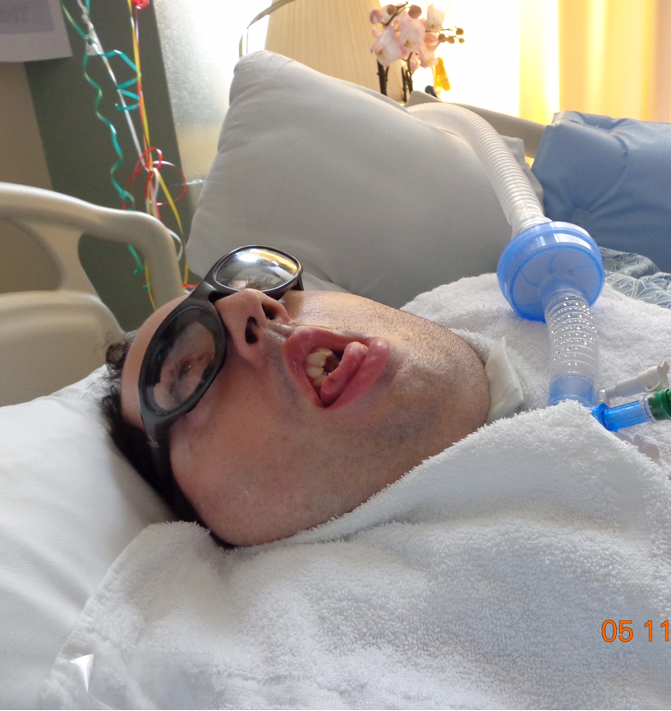
Why We Do This

Slide 10
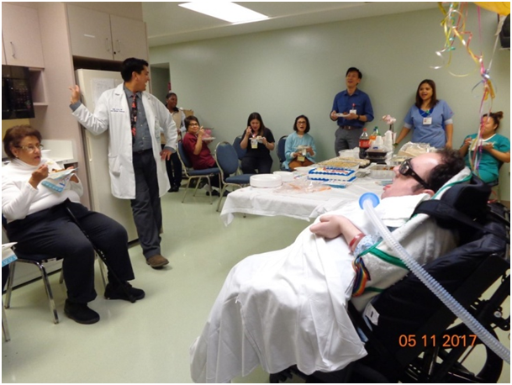
Why We Do This
JJ’s story as a near drowning victim
JJ drowned in a backyard pool alongside his sister Samira when she was 2 and he was 14 months old. JJ survived. Samira did not.
The photo was taken at JJ’s 40th birthday party this last May 11, 2017. In the picture with JJ are his Mom, Nadina, and his caregivers. JJ is California’s oldest living near-drowning victim under the care of the CA Department of Developmental Services.
According to CA’s EPICenter injury data from 2010 to 2014 more than 160 California children ages 1 to 4 died due to drowning. Most of these drowning incidents occurred in backyard pools. For every one drowning fatality there are another 4 to 5 children who drown, but survive, and many of these children have permanent brain damage.
During a five year period, from 2010 to 2015 more than 740 California children aged 1 to 4 years old were hospitalized due to a near-drowning incident. As of December 2016, CA’s Department of Developmental Services is currently providing care to 755 near-drowning victims with brain damage.
For the parents and families of children who have suffered a near-drowning caused brain injury, the drowning incident is just the start of a long difficult and expensive journey through hospitalizations, rehabilitation, around the clock care, special education, and other issues that impact the whole family.
For the last 14 years JJ has been institutionalized in a round the clock care facility at a monthly cost of $30,000.
Because of JJ’s brain injury due to drowning, JJ’s two younger brothers never got to run and play with their older brother.
This is the other side of the drowning story for far too many California children.
Drowning is preventable.

Slide 11


How the Project is Organized
8 working subcommittees organized around eight leading causes of Unintentional Injury: Traffic, Non-Traffic, Drowning, Poisoning, Suffocation, Burns, Falls and Sports
Subcommittee rosters made up of over 50 experienced national, state and local safety experts
Project housed under 501c3 CA Coalition for Children’s Safety and Health (CCCSH)
Admin and staffing through CCCSH

Slide 12
Who is Involved, Who are the Project Stakeholders
Project was designed by more than 70 initial stakeholders - Example & partial list of stakeholders:
  Injury prevention and safety groups including by not limited to: Safe Kids International & CA, CA Coalition for Children’s Safety and Health, Drowning Prevention Foundation, Children’s Safety Network, Safety Belt Safe USA, KidAndCars.org, Impact Teen Drivers, National Safety Council, Advocates for Highway and Auto Safety, etc.
  Children’s Hospitals: Los Angeles, Oakland, L. Packard, Central CA, LA, Shriners
  Insurance associations: Assoc CA Life Health Ins Co (ACLHIC), CA Assoc Health Plans, Personal Insurance Federation of CA, CA Health Plan Association
  State agencies: Emergency Med Services Authority, CA Department Public Health Safe and Active Communities, Office of Traffic Safety
  Federal agency: Consumer Product Safety Commission
  Healthcare: American Academy of Pediatricians – CA
  Public Health: Health Officers Association of CA

Slide 13
Current 2019 Legislation – See handouts
AB 1267 (R. Rivas) Graduated Driver License program age range 18 to 21 y/o
  CA’s GDL decreases young novice driver fatal crashes by 40% to 50% (250 to 500 lives a year)
SB 371 (Caballero) School bus stop law enforcement use of video technology
  3.7 million stop law violations a year, only 800 tickets a year, 125 children fatally or severely injured in last 10 years
AB 1336 (Smith) Updates Kids Plates funding programs unintentional injury prevention issues KP can be used to fund
  Adds pedestrian, sleep suffocation, poisoning, sports concussion and heat stroke, kids left in cars, bicycle safety courses to existing list

Slide 14
Recent passed bill implementation efforts
AB 2007 (McCarty) Sports concussion safety – passed 2016
  Requires all community sports programs to have sports concussion safety training, remove from and return to play protocols for coaches and assistant coaches
  And, concussion safety education for parents and players
SB 442 (Newman) Updates to CA Pool Safety Act
  Drowning remains leading cause of death along with congenital abnormalities for children ages 1-4 years old
  All residential pools new, being retrofitted or associated with home sale have two safety barriers to help prevent child getting to pool without active adult supervision
AB 3077 (Caballero) Updates CA’s bicycle helmet law enforcement
  California’s bicycle helmet law for children up through age 18 now less than 20% compliance – 18,000+ annual head injuries associated with bicycle crashes in ER a year
  Makes helmet law violations “fix-it-tickets” requiring child to go through bicycle safety course and parent attesting the child has and will wear bicycle helmet

Slide 15
Legislation Concepts Planned for 2020
Window fall safety
  Residential building window falls cause catastrophic multiple blunt trauma injury
  New York City ordinance is model law – Reduced childhood window falls by over 90%
Baby/Infant sleep suffocation local prevention program funding
  Infant/baby sleep suffocation still leading cause of unintentional injury death
Kids Plates funds reform – Child Care Provider Health and Safety Education and Training
  Update the use of Kids Plates funds to support increasing access to child care provider health and safety training programs

Slide 16
Need Other Children and Youth Advocacy Groups To:
Become member of the CCCSH coalition –
  Contact Catherine Barankin, Executive Director at cbarankin@aol.com
And
Having representation on one of the Unintentional Injury Prevention Strategic Plan Project 8 working subcommittees
Support Project unintentional injury prevention legislation
Educate your network about unintentional injury and importance of elevating prevention

Slide 17
Questions?

Slide 18
Contact Information
Cathy Barankin, Executive Director - CCCSH
cbarankin@aol.com
Or
Steve Barrow, Program Director - CCCSH
scbarrow88@gmail.com or Cell phone 530 902-5551

Slide 19
Addendum Information about Current Project Objectives and
What the Project is focused on and Is not focused on
The CA Unintentional Injury Prevention Strategic Plan Project is focused on supporting:
Creation and growth of collaboration and cooperation between organizations, proactive in civic engagement, and advocating for the development of best practice policies, laws, programs and funding that support unintentional injury prevention statewide
Institutionalize best practices that are proven, effective and can be replicated
Passage of new and updating existing unintentional injury focused laws based on best practices
Increase resources to help sustain and grow to capacity local and regional “hands on” safety programs, organizations and projects
The CA Unintentional Injury Prevention Strategic Plan Project was not created to provide hands on local safety and prevention services, unless working with Project stakeholders to support pilot program(s) to test a hypothesis toward advancing unintentional injury prevention

Slide 20
Current Project Objectives Traffic related issue current Priorities
Teen driver safety – Implement national recommendation GDL age change from 18 y/o to 21 y/o – cover 18, 19, and 20 year old new drivers with GDL – 2019 legislation
Safety Seat Technicians – Create statewide safety seat technician goals and strategic plan, increase number of sustainable certification training courses and number of local safety seat technicians
Revamp CA’s bicycle helmet law citation to be fix-it-ticket rather than only a $197 punitive citation -- allow local law enforcement or other local jurisdiction waive ticket if parent or guardian shows the child has successfully completed a bicycle safety program, and has an appropriate safety helmet to wear
Increase sustainable support for local and regional school and community-based hands-on bicycle and pedestrian safety programs
Increase collaboration, cooperation and communications between local and state agencies responsible for road and intersection design, maintenance and revamp, with focus on “hotspots” where multiple vehicle, bicycle and pedestrian crashes occur

Slide 21
Current Project Objectives Non-Traffic – Kids left in cars, backovers and frontovers
Increase support in underserved communities around non-traffic issues and prevention actions that need to be taken by parents, caregivers, children and community leaders, regarding kids left in cars, backovers and frontovers
Support development of technologies to help prevent infants and children being left in vehicles (Ex: Congressional bill “Hot Car NHTSA Regulations”)
Increase public awareness regarding backovers and access to affordable rearview vehicle cameras
Reform incident reporting of kids left in cars, backovers and frontovers, to increase accurate picture of these issues in CA

Slide 22
Current Project Objectives
Drowning prevention
Implementation of legislation updating CA’s 1996 Pool Safety Act law – SB 442 (Newman)
Ensure drowning prevention concepts are included in school, hospital discharge, parent training, swimming lessons and Pediatrician safety lessons and curriculums
  Core concepts are: all water comes with risk and understanding water risks; maintain safety barriers on residential pools and spas; active adult supervision of children around water; and having a strategic safety plan, including rescue, in place before accessing water

Slide 23
Current Project Objectives
Suffocation Prevention
Suffocation prevention is primarily focused on sleep suffocation, which is by far and away the leading cause of suffocation-injury and death to infants and babies in CA
  Support the development of, refining and defining of the attributes associated with best practice local sleep suffocation prevention programs
  Increase sustainable support to underpin ongoing access to local best practice sleep suffocation prevention programs
  Institutionalize sleep suffocation prevention policies and protocols at all California hospitals regarding parent and caregiver sleep suffocation prevention knowledge and support upon the discharge of a baby or infant from the hospital
Institutionalize suffocation education for parents, caregivers and families about preventing babies, infants and young children from ingesting small objects – working with hospital leadership, child care councils, EMSA primary health and safety training course curriculum review for licensed child care providers

Slide 24
Current Project Objectives
Poisoning Prevention
Support the retention of Poison Control Centers in the CA state and federal budgets
Institutionalize best practices prescription med drop off policies and protocols for all pharmacies, to prevent children and youth access to unused prescription medication

Slide 25
Current Project Objectives
Falls Prevention
The main child fall focus is currently on institutionalizing best practice window fall prevention, with a primary focus on multistory residential buildings. The best practice window fall prevention strategy is to institutionalize the New York best practice window fall ordinance onto the California landscape. New York was able to nearly eradicate its child window fall public health problem, reducing fall incidents there by more than 90%.
Comment on senior falls: Falls create one of the largest numbers of unintentional injuries for children and seniors. For children common falls on the same surface are less of a major unintentional injury issue. For seniors common falls can be deadly or a contributor to decline in health. The Project will - where appropriate - support information exchange about senior falls. So many of California’s children in underserved communities depend on grandparents/grand uncles, aunts for care, losing these guardians and caregivers impact stability of children’s lives.

Slide 26
Current Project Objectives
Burns Prevention
A lot has been accomplished over the years in California through building code requirements, technology, state of the art fire departments, and better building materials. There are still too many home and kitchen fires resulting in death and severe injury.
Re-instate fire department personnel positions in all areas of the state, with an expertise in community engagement, safety, prevention and unintentional injury prevention education
Ensure all local hands on burn prevention and safety programs have access to free long term (10 year battery) smoke alarms, to install as a priority in homes where children live or are cared for
Institutionalize safety inspection support and remediation programs for all local housing where children live, deemed to be at risk of fire dangers, including kitchen fire dangers, due to the age, design, kitchen or safety equipment, and status of building maintenance.

Slide 27
Current Project Objectives
Sports Related
Implementation of recently passed sports concussion safety protocols for all community sports programs (AB 2007 Chapter 516 of 2016)
Institutionalize community-based sports program coaches training and parent and player education about sports related heat stroke, cardiac arrest and spinal injury prevention, and action steps when these unintentional injuries occur.

Slide 28
Outcomes - Measurable Metrics Examples of outcomes data that can be tracked
There are dozens of types of data that can be tracked with existing data systems. Here are a few examples:
Number of and types of injuries due to teenage driver involved crashes, and cause of the crash – especially distracted driving underlying causes
Number of vehicle crashes resulting in death or injury involving children required to be in safety seats
Number and outcome residential pool and open body of water drownings
Number of death and injuries due to sleep suffocation
Number of head injuries associated with bicycle crashes
Number of burn deaths and injuries due to home and kitchen fires
Number of poisonings due to misuse of Rx medications
Number and severity of sports related concussions
Number of children harmed – fatal and non-fatal - due to being left in vehicles unattended, backover or frontover incidents

Slide 29
National Examples of Data Sources
Nationally unintentional injury data sources
  CDC WISQUR http://www.cdc.gov/injury/wisqars/index.html (Web-based Injury Statistics Query and Reporting System)
  Children’s Safety Network https://www.childrenssafetynetwork.org/
  KidsSafe
  KidsAndCars.org
  Children’s Hosp of Philadelphia Center for Injury Research and Prevention
  Consumer Product Safety Commission
  National Highway Traffic Safety Administration
  Insurance Institute

Slide 30
State Examples of Data Sources
State level settings that track detailed unintentional injury data collected from hospitals, first responders and public health community
CA Dept of Public Health “EPICenter” http://epicenter.cdph.ca.gov/
CA Highway Patrol SWITRS
County Health and Public Health Agencies
CA state and local Child Death review data
CA Emergency Medical Services Authority Trauma Data and CEMSIS

