Slide 1


Child Rights & Remedies
Fall 2012

Slide 2
CAI Team
Robert C. Fellmeth -- Executive Director -- cpil@sandiego.edu
Elisa Weichel -- Administrative Director/Staff Attorney -- eweichel@sandiego.edu
Christina Riehl -- Senior Staff Attorney -- criehl@sandiego.edu
Melanie Delgado -- Staff Attorney -- mdelgado@sandiego.edu
Mercedes Lanznaster -- Executive Assistant -- mlanznaster@sandiego.edu
Christina Falcone – Executive Assistant – cfalcone@sandiego.edu
Sacramento: Ed Howard
Washington, D.C.: Amy Harfeld

Slide 3
Children’s Advocacy Institute
Founded at the USD School of Law in 1989
California’s premiere academic, research, and advocacy organization seeking to improve the lives of children and youth
Special emphasis on improving the child protection and foster care systems and enhancing resources that are available to youth aging out of foster care and homeless youth.
Offices in San Diego and Sacramento, and an affiliate office in Washington, D.C.
Seeks to leverage change for children and youth through impact litigation, regulatory and legislative advocacy, and public education.
Active at the local, state, and federal levels, CAI’s efforts are multi-faceted — comprehensively and successfully embracing all tools of public interest
advocacy to improve the lives of children and youth.

Slide 4
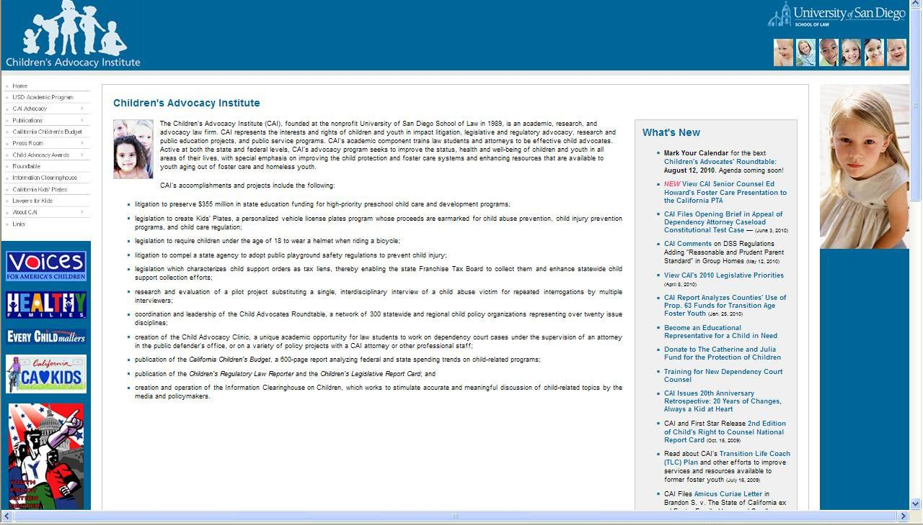
CAI Web site: www.caichildlaw.org

Slide 5

The course syllabus is the text’s table of contents.
You can purchase the book from the bookstore

Slide 6
Prof. Fellmeth’s Office Hours
Mondays from 2:15 pm to 4:00 pm
Wednesdays from 2:15 pm to 6:00 pm
You can also email Prof. Fellmeth at cpil@sandiego.edu.

Slide 7
Handouts
CR&R General Information, Fall 2012
Clinic Information
Glossary

Slide 8
Clinical Opportunities
  Dependency Clinic: assisting attorneys in the representation of abused and neglected children in Dependency Court (4 units)
  Delinquency Clinic: assisting attorneys in the representation of accused children in Delinquency Court (4 units)
  Policy Clinic: working on policy advocacy (legislation, rulemaking, impact litigation, research, etc.), assisting with the Homeless Youth Outreach Project, or serving as an Educational Representative for a youth involved in Juvenile Court proceedings (1–3 units)

Slide 9
Pop Quiz!

Slide 10
1. The average age of a California TANF¹ mother is:
a. 17
b. 34
c. 26
  19
¹TANF = Temporary Aid to Needy Families, which replaced AFDC (Aid to Families with Dependent Children) in 1997. TANF is the federal-state cash safety net for impoverished families with children.

Slide 11
2. The percent of California’s TANF mothers under age 19 is:
61%
2%
21%
18%

Slide 12
3. The average age of a male impregnating an unwed teen is:
the same as the female
0 to 3 years older
more than six years older
3 to 5 years older

Slide 13
4. In 1973, 84% of children living in families below the federal poverty line received TANF (AFDC) support; the percentage in 2010 in California was:
68%
35%
98%
88%

Slide 14
5. In 1995, TANF (AFDC) spending was what percentage of the federal budget?
26%
1.5%
6%
16%

Slide 15
6. In 1989, TANF type support for a three-person family was $1,150 per month in current dollars; the maximum grant for the same family in 2010 is:
$1,100
$960
$790
$635

Slide 16
7. In 1995 (before welfare reform restrictions), each additional child increased benefits by:
$600
$450
$320
$105

Slide 17
8. The median annual income of a single mother with 2 young children is:
$12,500
$29,000
$18,000
$22,000

Slide 18
9. The median annual income of a married couple with 2 young children is:
$18,000
$32,000
$56,000
$26,000

Slide 19
10. Of the 2.4 million absent fathers tracked by California agencies, the average amount paid for each of the 4.5 million children they have fathered per month is:
$160
$324
$54
$95

Slide 20
11. The unwed birth rate nationally and in California is:
10%
15%
22%
40%

Slide 21
12. The unwed birth rate among African Americans is:
15%
22%
32%
70%

Slide 22
13. The percentage of families who have resided in California less than one year and are receiving TANF is:
35%
18%
6%
1%

Slide 23
14. The average U.S. youth is self-sufficient at age 26, and parents spend a median of $44,500 on their kids post age 18 to help them reach self-sufficiency. The median total amount received by foster children for whom the state is the parent after they turn 18 is:
$70,000
$45,000
$30,000
$8,000

Slide 24
15. Most non-kin adoptions of foster kids come from family foster care providers. While those providers receive an average of $530 per month per child, the average amount received by a group home per month per child is:
$700
$1,000
$2,500
$4,100

Slide 25
16. The now-retiring Boomer Generation has enacted medical benefits and “defined benefit” pension plans for itself, including Medicare, Social Security and public employee pensions. Their unfunded liability over the next generation that must be met by future taxpayers totals:
$15 billion
$150 billion
$1 trillion (a thousand billion)
$50 trillion

Slide 26
17. The carrying charge at 5% of the unfunded liability to finance the Boomer Generation’s care and pensions, and to carry the federal budget deficit, will total in dollars per year per family:
$1,000
$5,000
$10,000
$25,000

Slide 27
18. The total deficit to be imposed per family to be borne for the pension / medical / federal budget unfunded liability is:
$20,000
$50,000
$100,000
$500,000

Slide 28
Purpose of Course
Legal Handles
Constitutional Concepts
How to Argue

Slide 29
Class Participation Points
(Why you should attend class and talk!)
  Participation points plus or minus (formerly “push points / pull points”) are given in this class. Your grade may be subject to adjustment by one step (e.g., from B to B+ or from a B to B–) depending on your attendance, participation, and oral performance in class.

Slide 30
Unusual Status of Children
Citizens, but immature

Slide 31
International Aspect of Child Rights

Slide 32
Role Playing
Children
Parents
State
ACLU
Feminist
Male Rights
Fundamentalist
Scalia

